Slide 1


Rescuing Leftover Cuisine
Mid-Hudson Area.
Siennah Yang

Slide 2
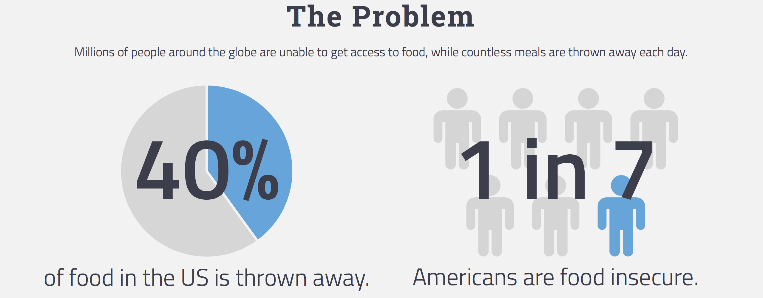
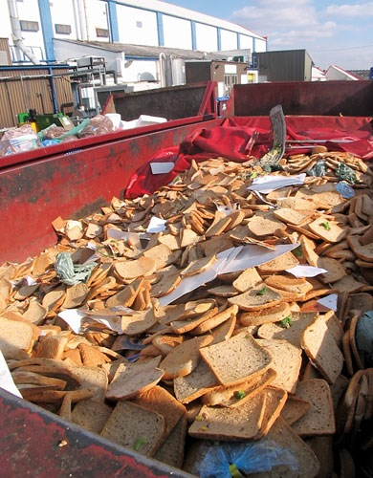
Notes:
Do the biscuit illustration

Slide 3
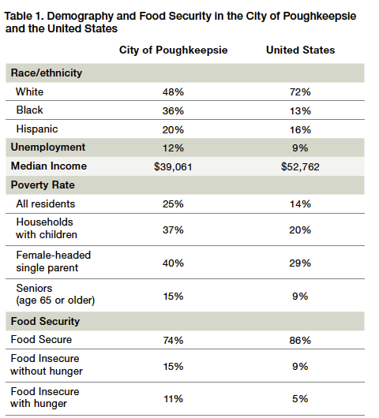
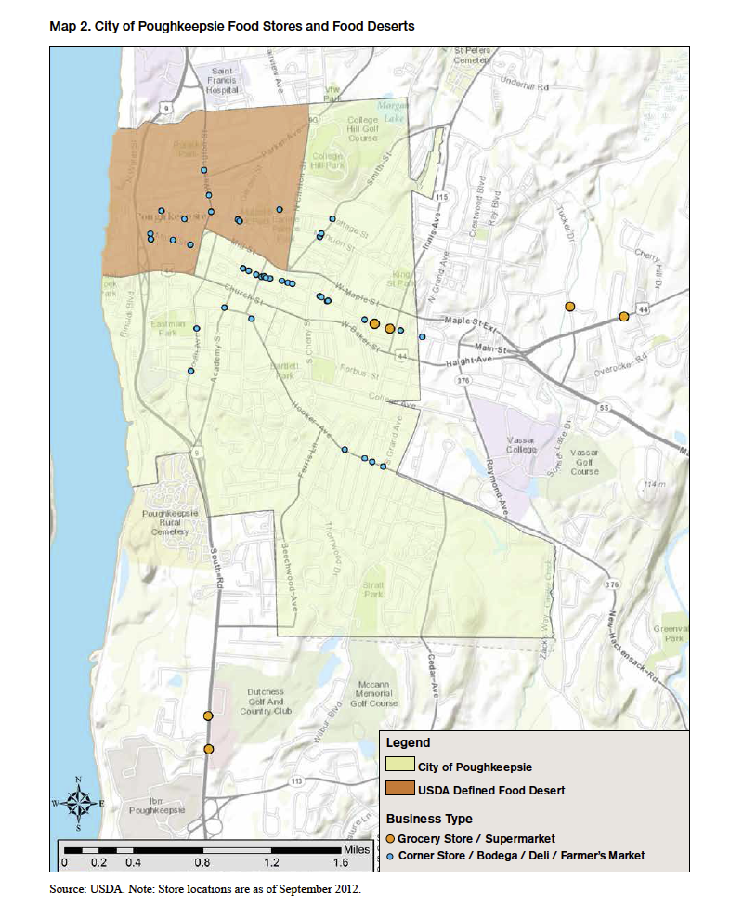
Food Insecurity in Poughkeepsie
Notes:
Poughkeepsie stareduced quality, variety, or desirability of diet; little indication of reduced food intake
Multiple indications of disrupted eating patterns and reduced food intake
When a person or a family has limited or uncertain availability of nutritionally adequate and safe foods ability to acquire acceptable foods in socially acceptable ways

Slide 4
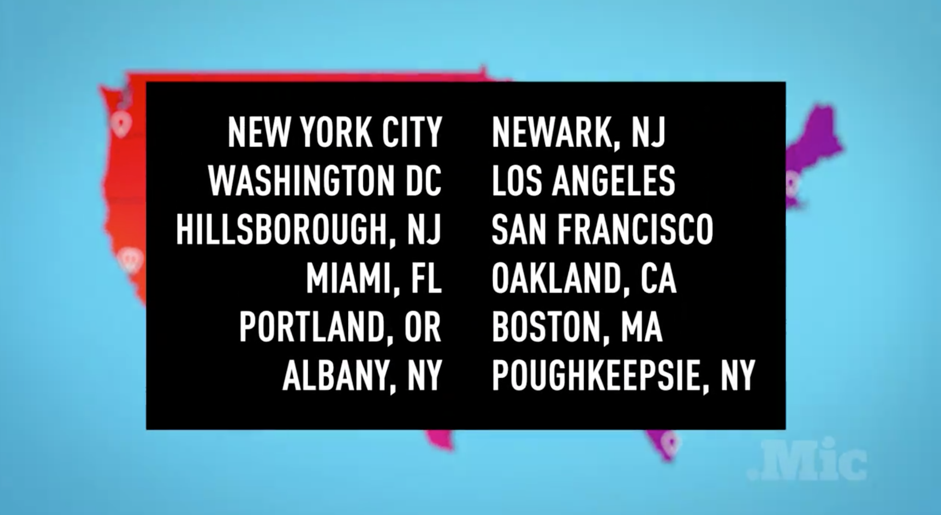

Slide 5


How RLC Works
Map all places that receive food.
Understand what food they need and when we can donate.
Food Recipient
Reach out to food industries with potential leftover food.
They can donate any type of food at any schedule and any amount.
Food Donor

Slide 6

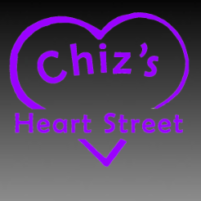





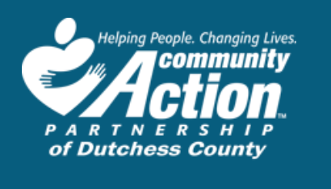
Some of Our Current Recipients

Slide 7


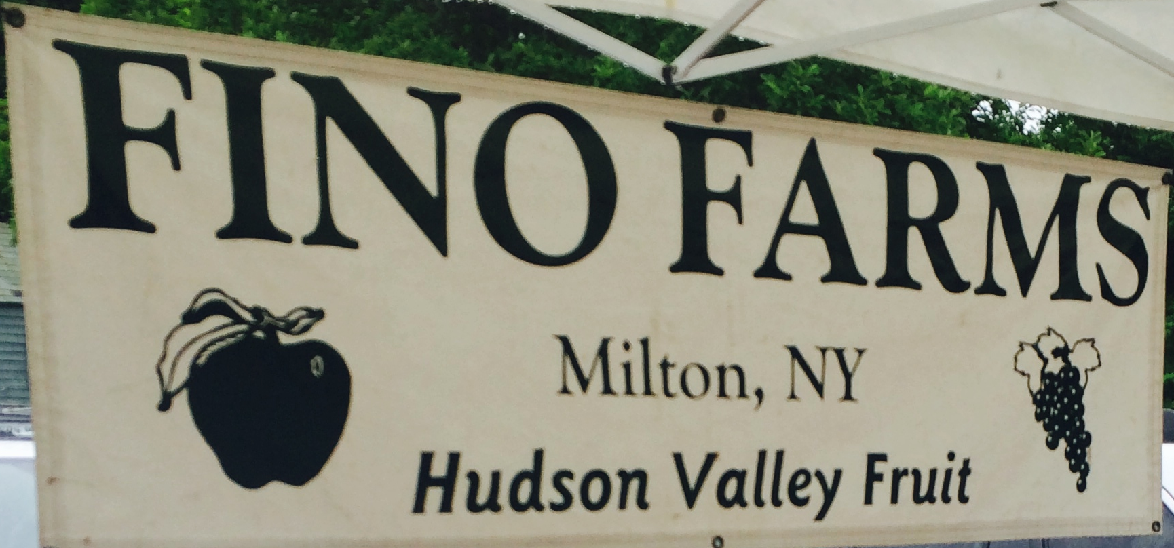


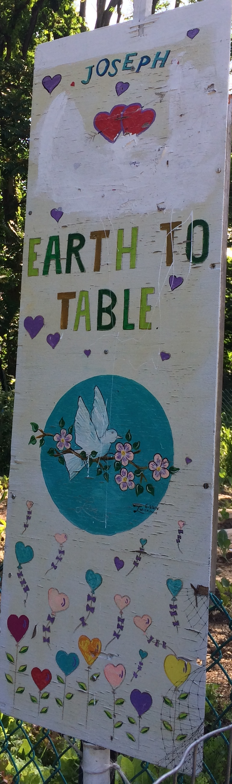
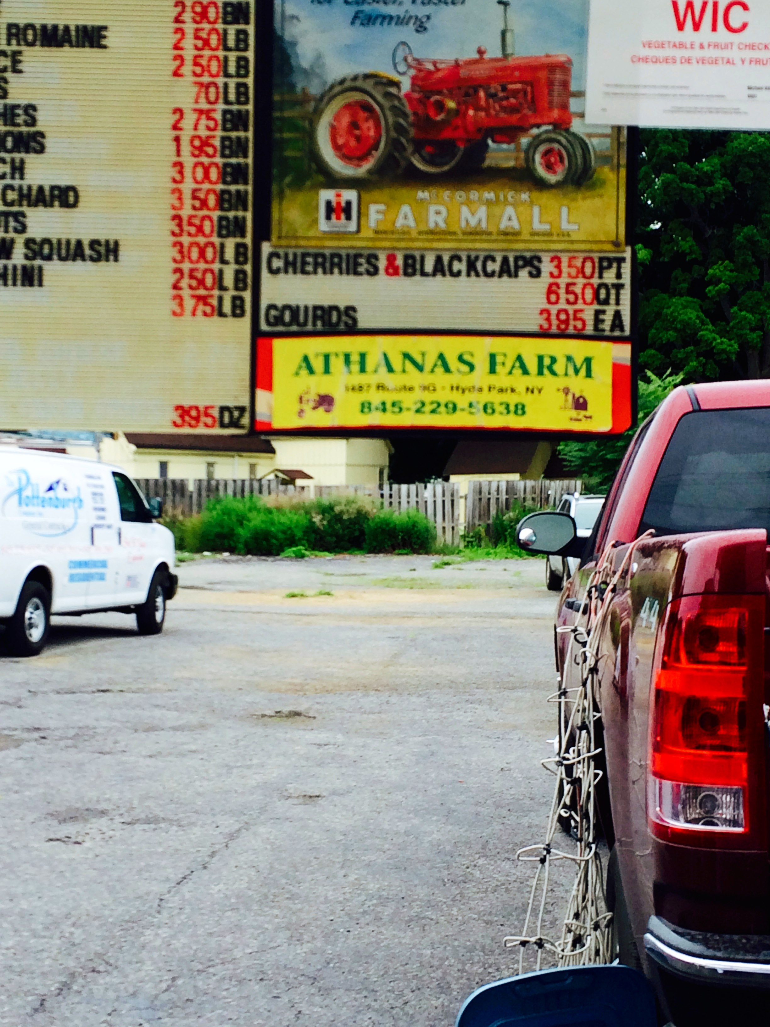



Some of Our Current Donors
+25 food donors!

Slide 8
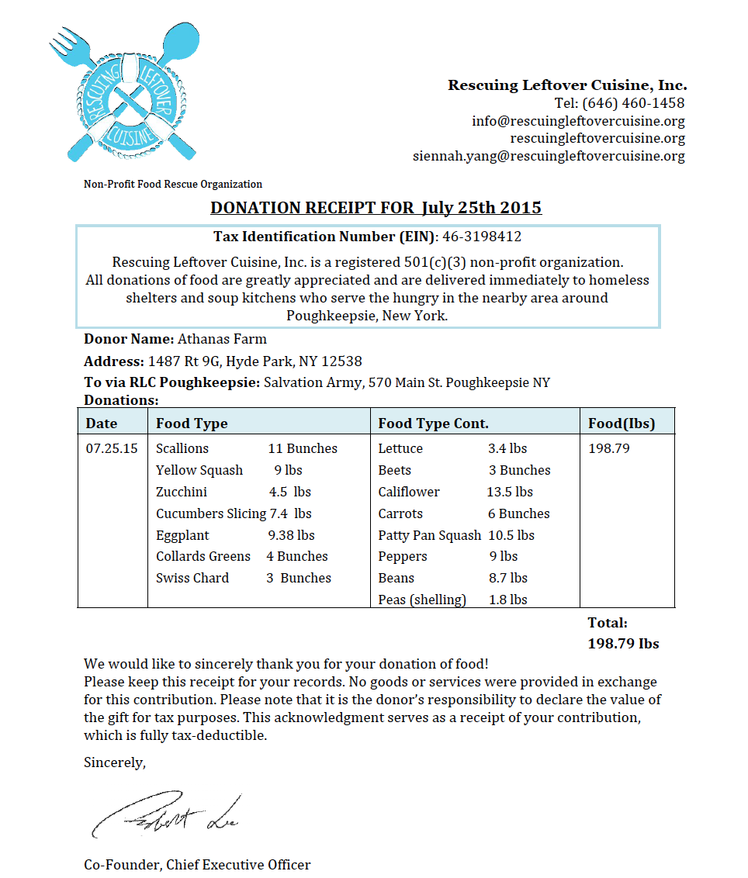
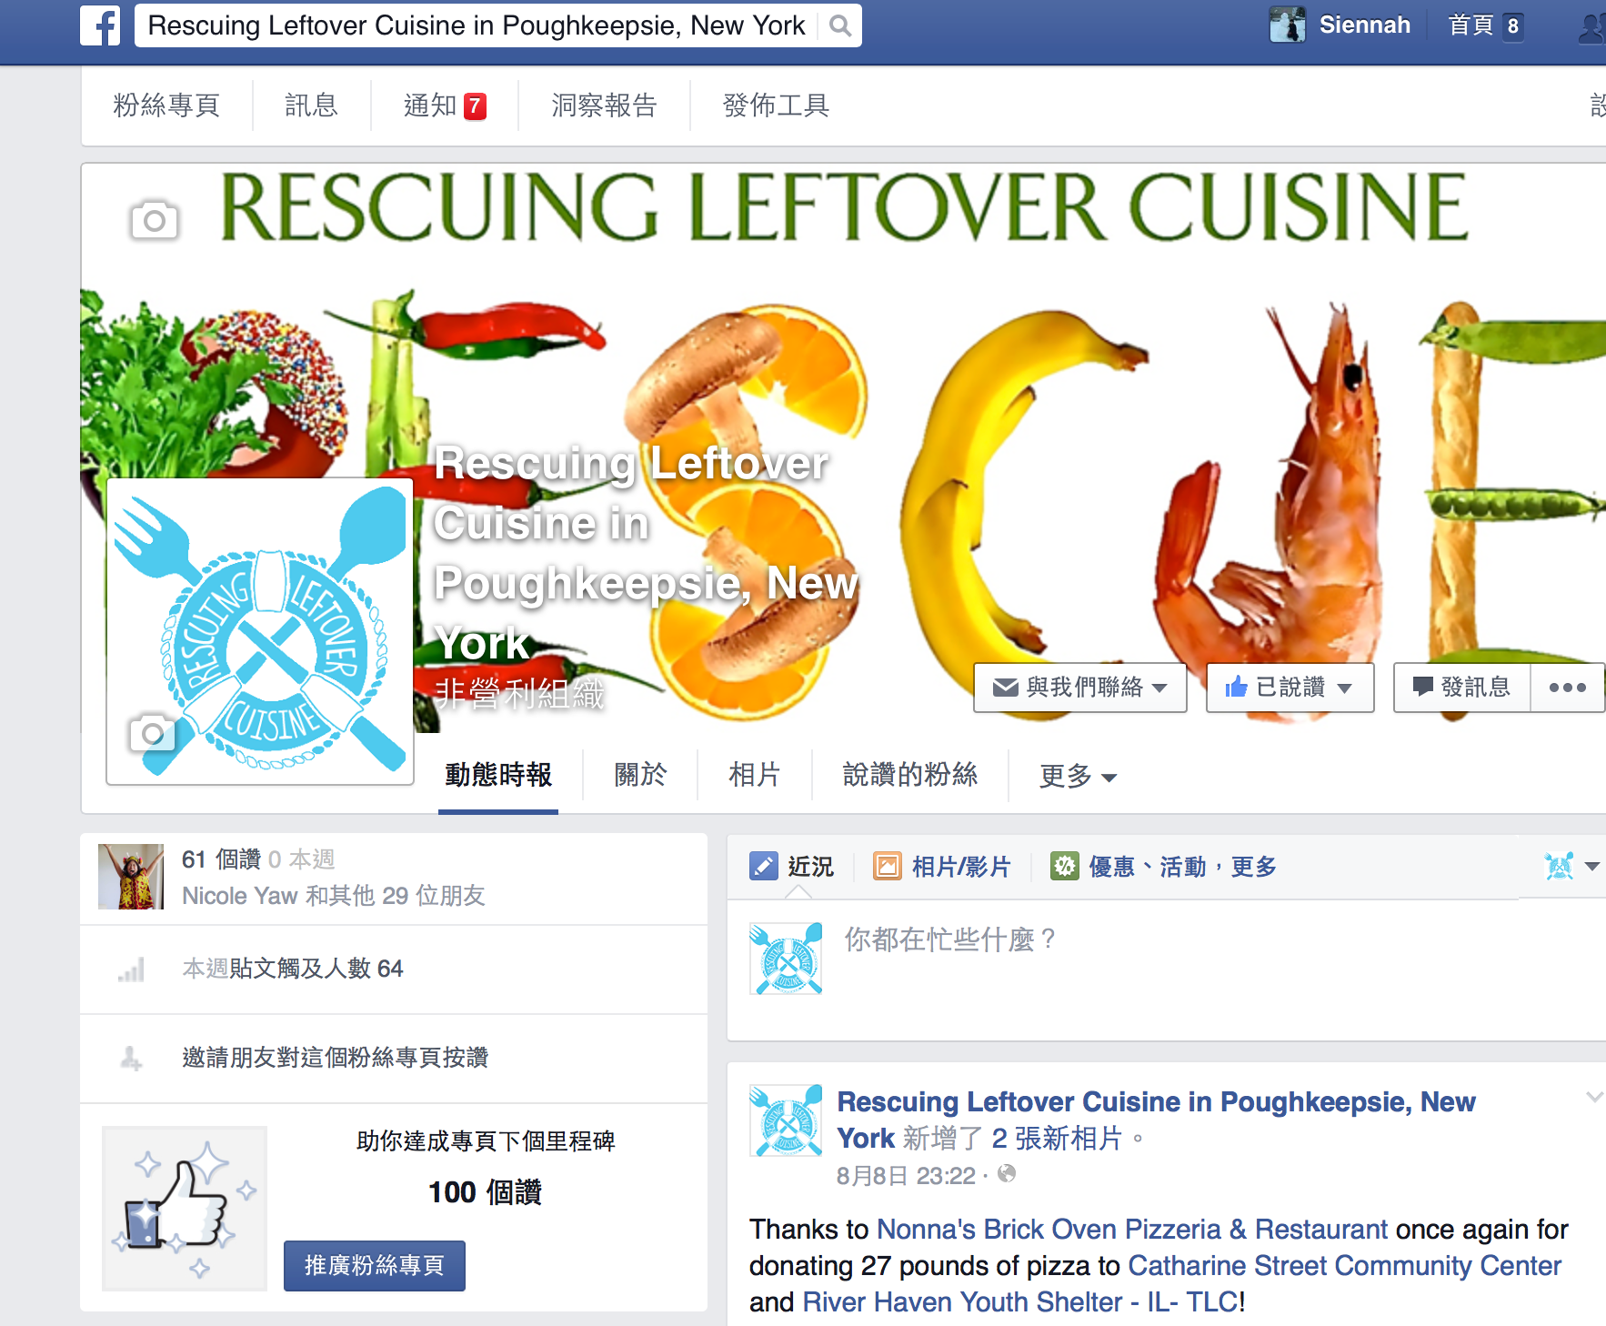
Why should they donate?
Brand Name publicized
All donations are 50% tax deductible with a RLC Donation Receipt
3. Bill Emerson Good Samaritan Food Donation Act:
Protects the donor and the recipient agency against liability, excepting only gross negligence and/or intentional misconduct.

Slide 9
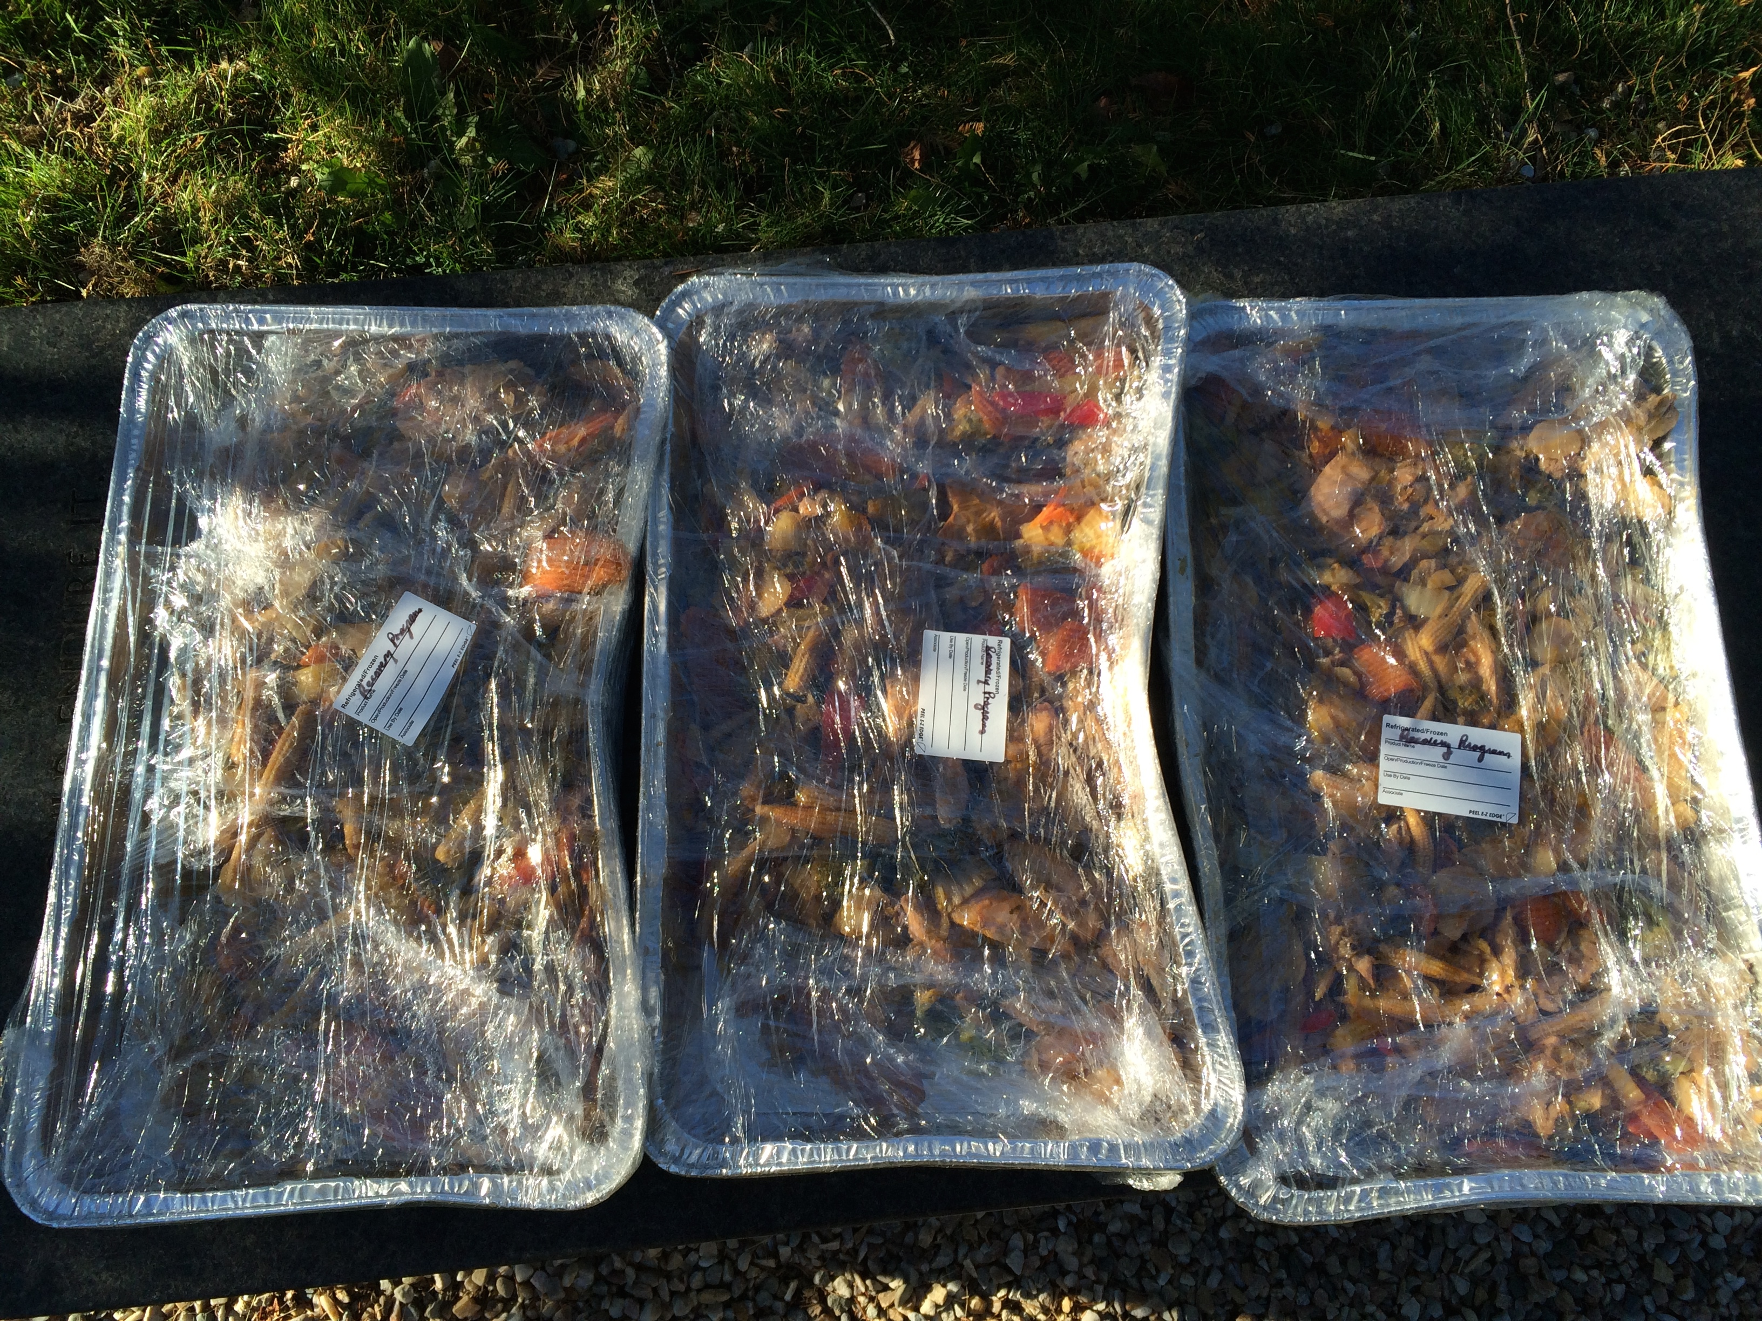
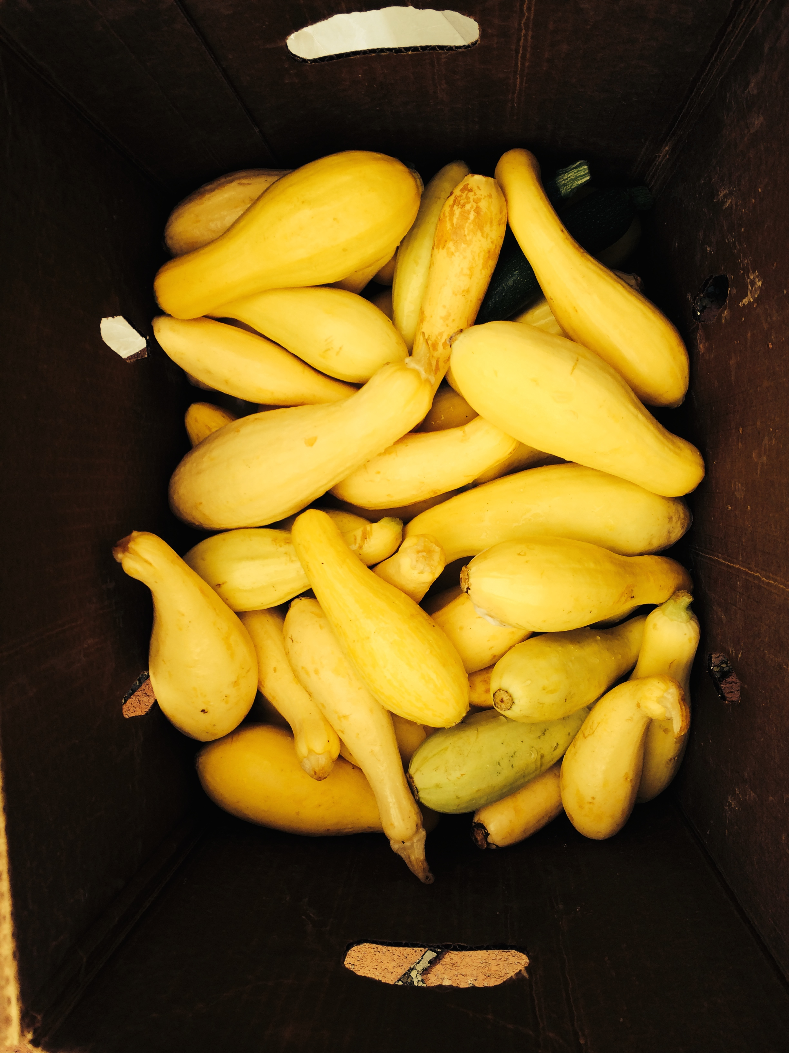
How RLC Works cont.
Volunteer
Rescuers
Food is all transported by volunteers.
Volunteer hours are flexible.
Partner with agencies and organizations in the area to raise awareness about food waste in the community.
Partner Agencies

Slide 10
Why RLC?
Integrative
Rescue efforts can be easily integrated to one’s schedule.
Community
Engaging
Form local partnerships to raise awareness about environmental and sustainable development in the community
Cost Effective
RLC as the most cost effective food rescue program
in the industry. $1 feeds 8 people. Cost less than 5 cents/lb to deliver.
Hassle-Free
Donate any type and amount of food at any time and schedule.
Flexible
RLC model is flexible for change.

Slide 11
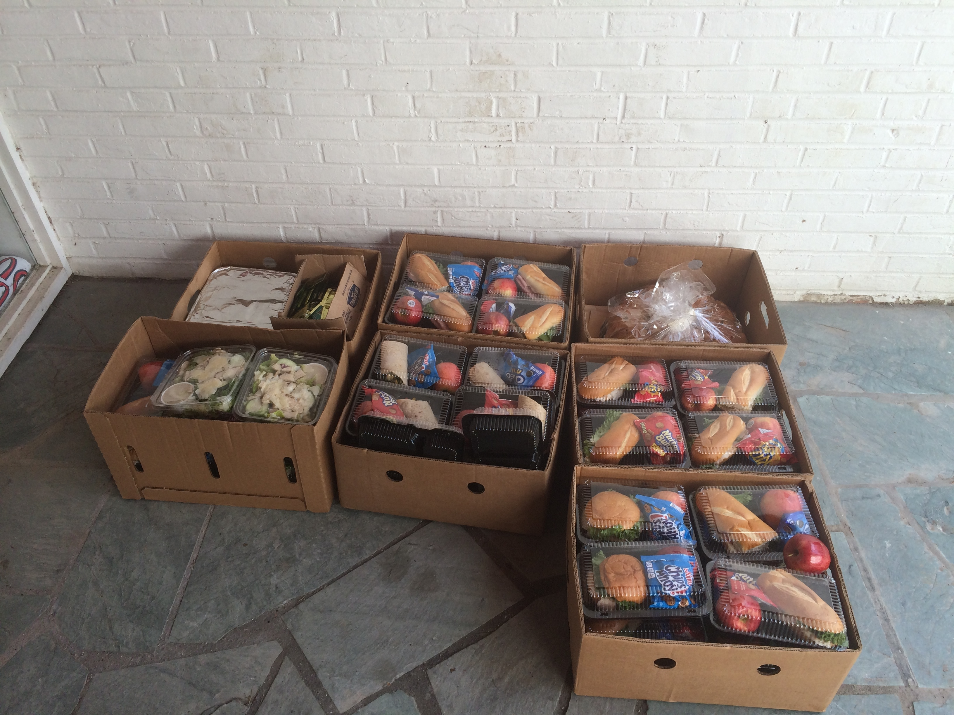
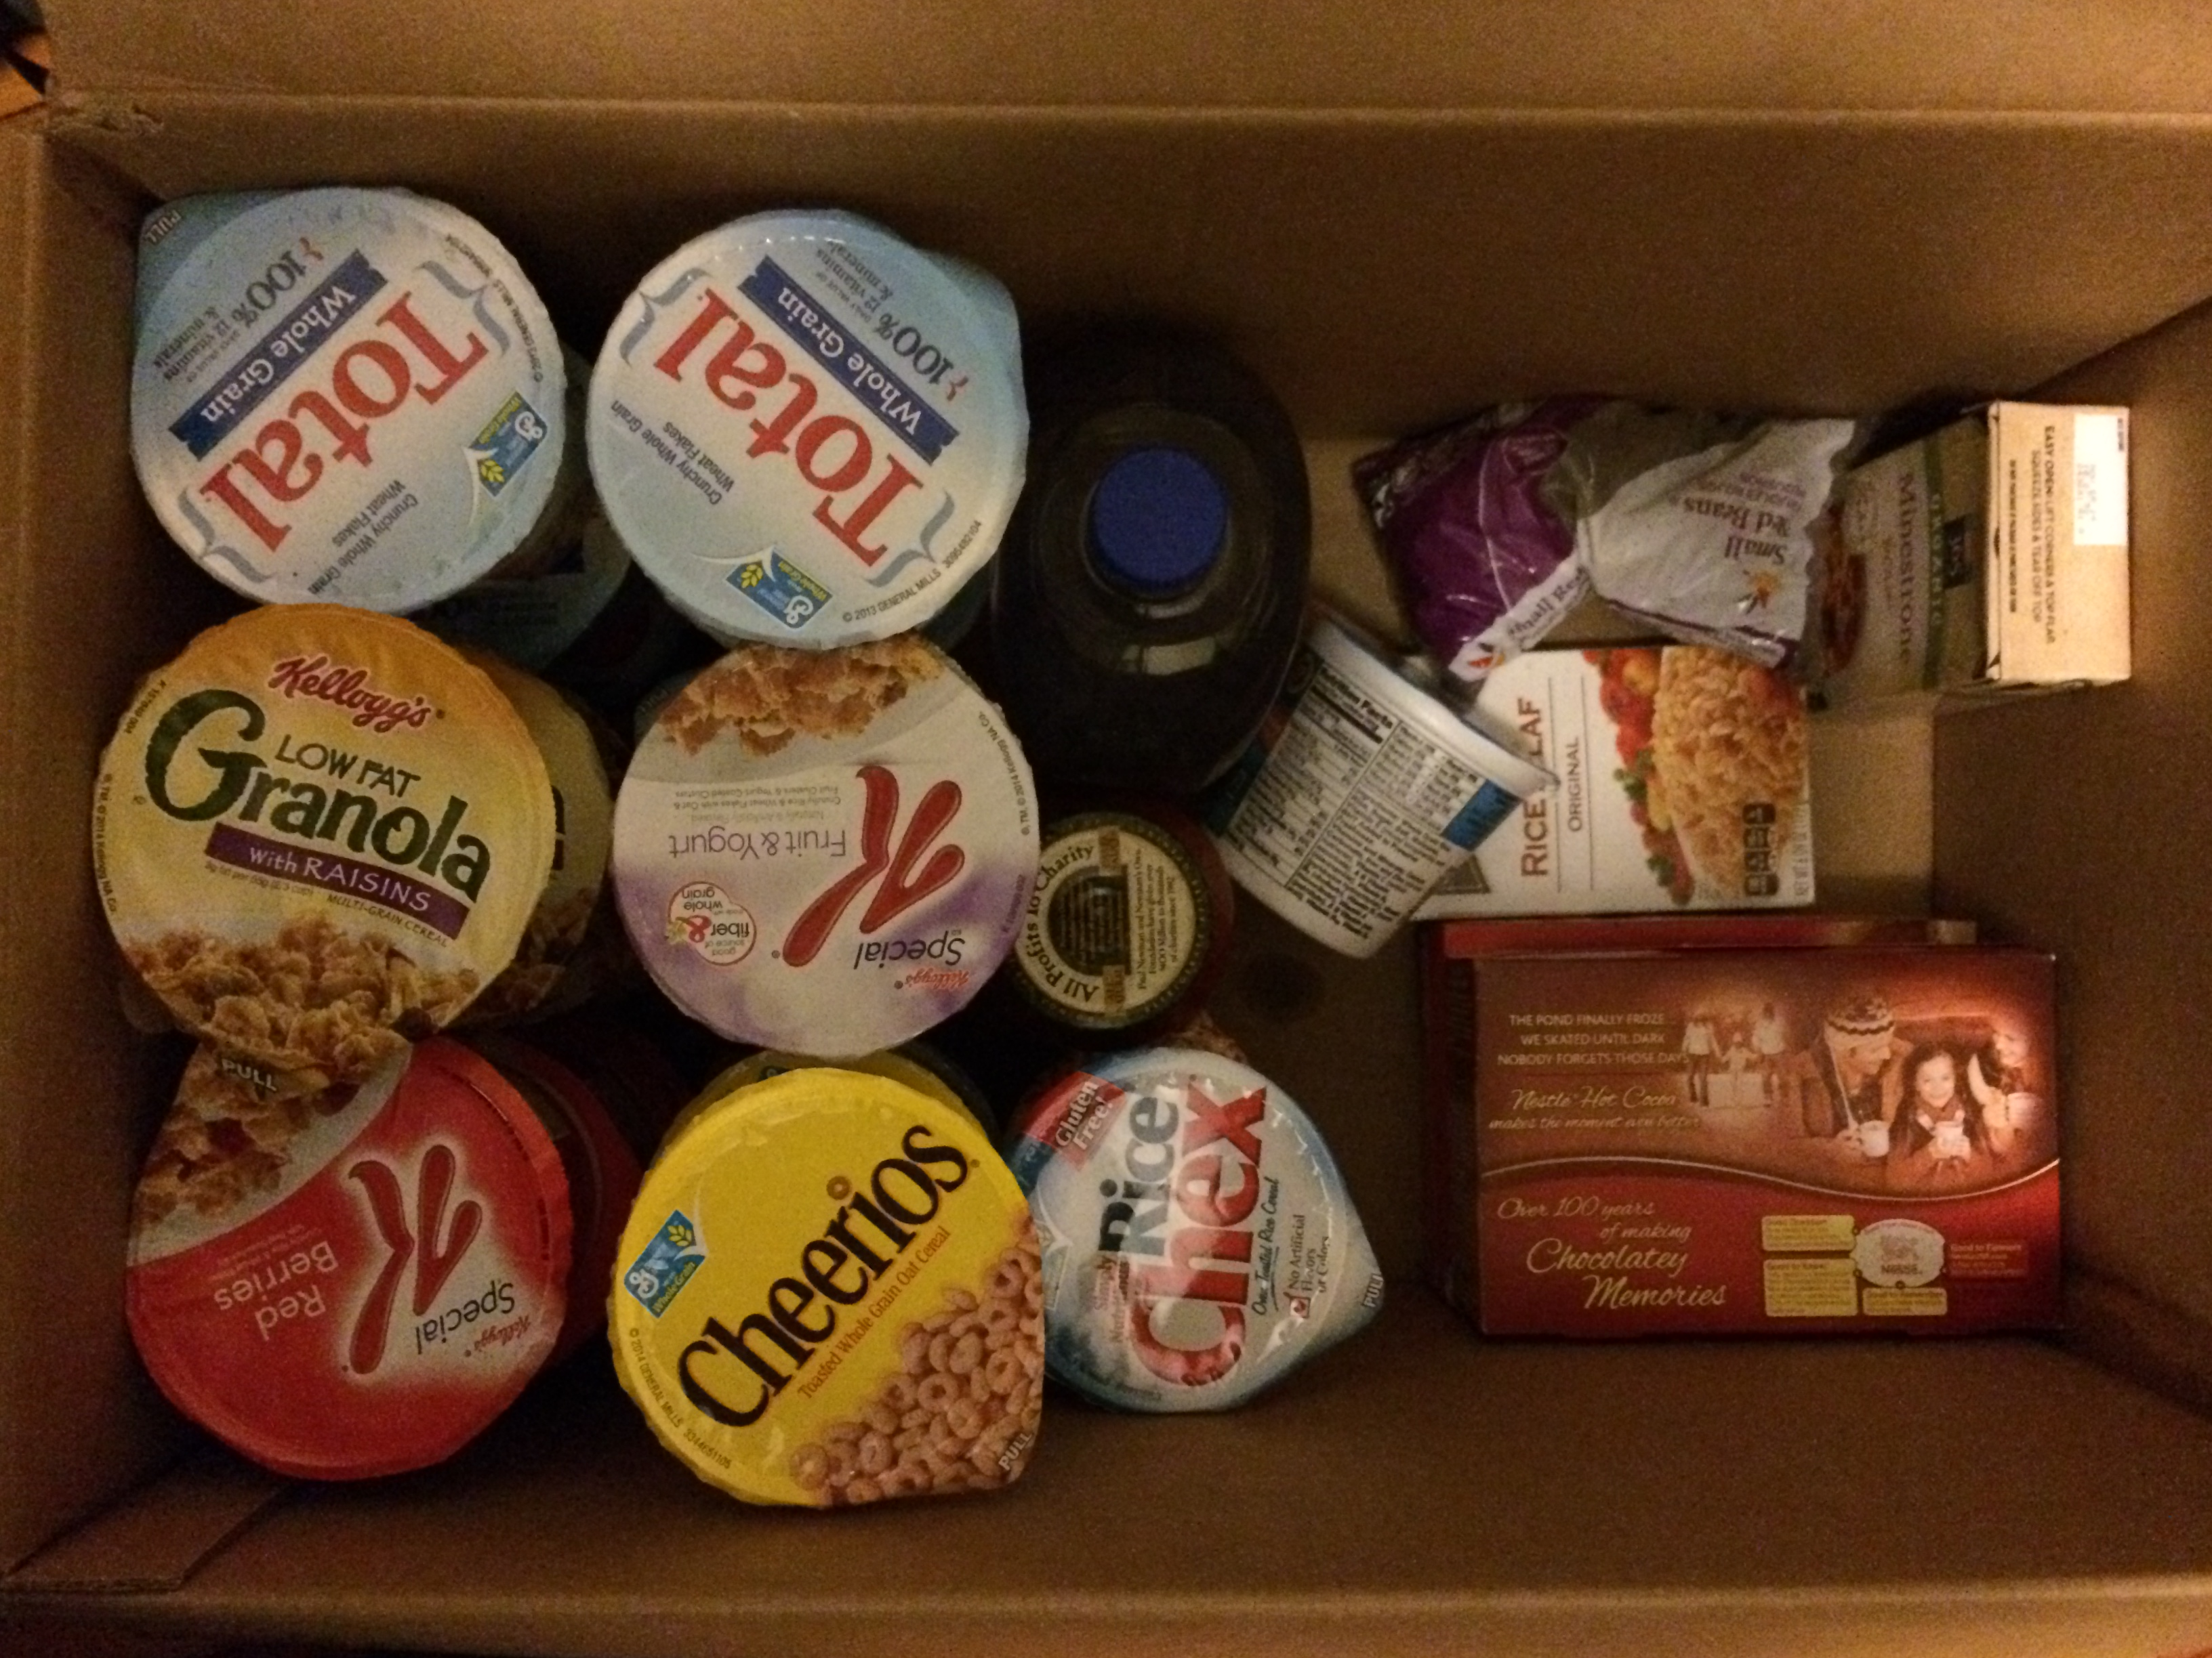
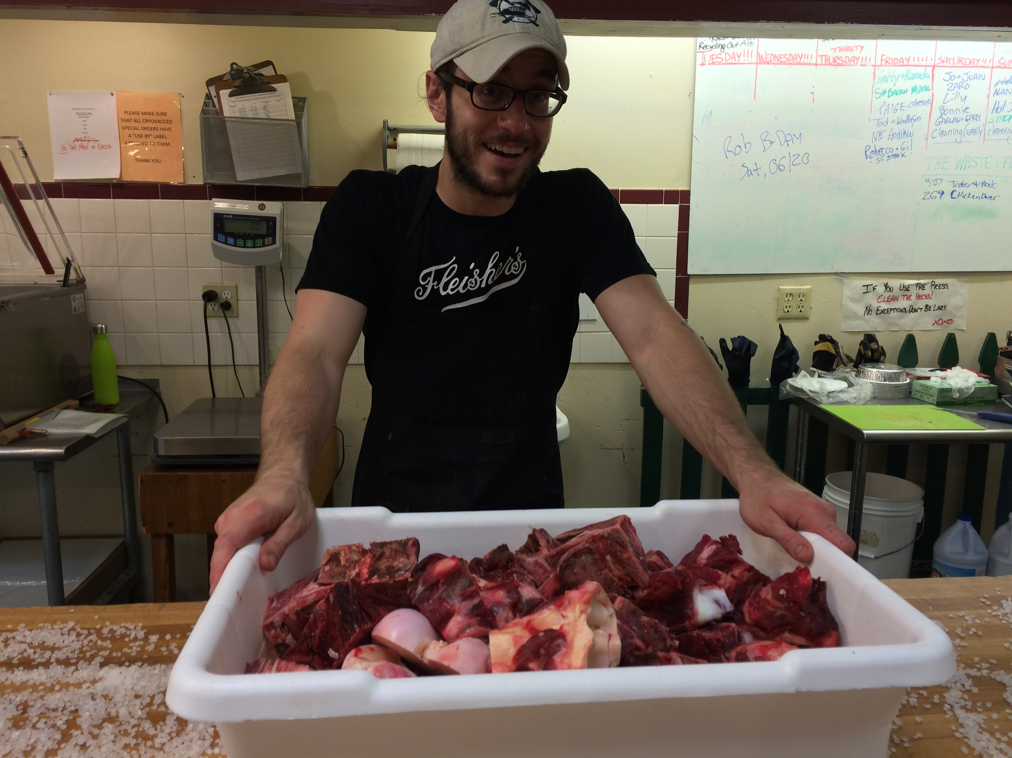
Costs and Issues
Transportation
Packaging and Containers
Publicity
Food Rescue Educational Outreach and Event Planning
Volunteer Training
App Development

Slide 12
Partnerships and Projects
Dutchess Outreach Food Hub
Jewish Social Action Committee
Local Churches
Vassar Dining and Just Food
Hudson Valley Regional Council & Feedback Global—Feeding the 5000

Slide 13
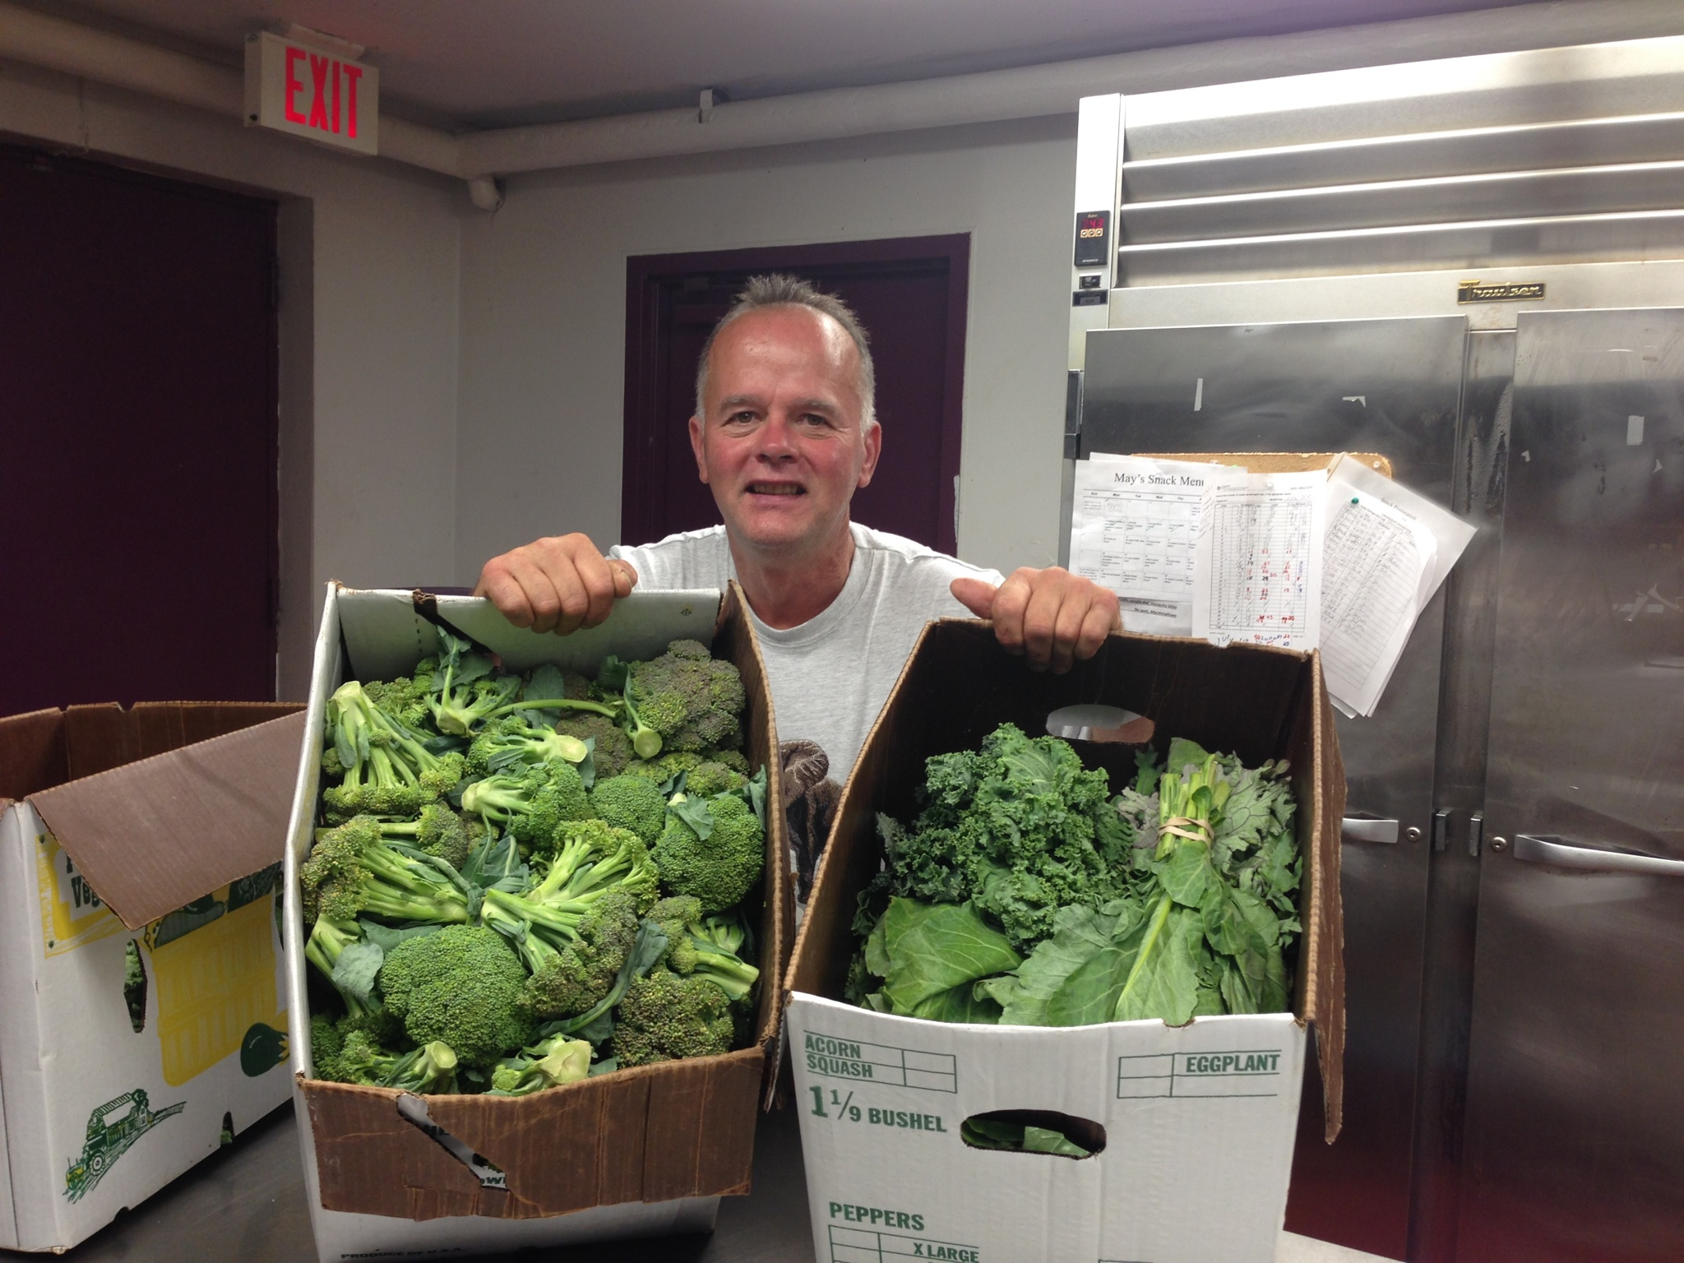
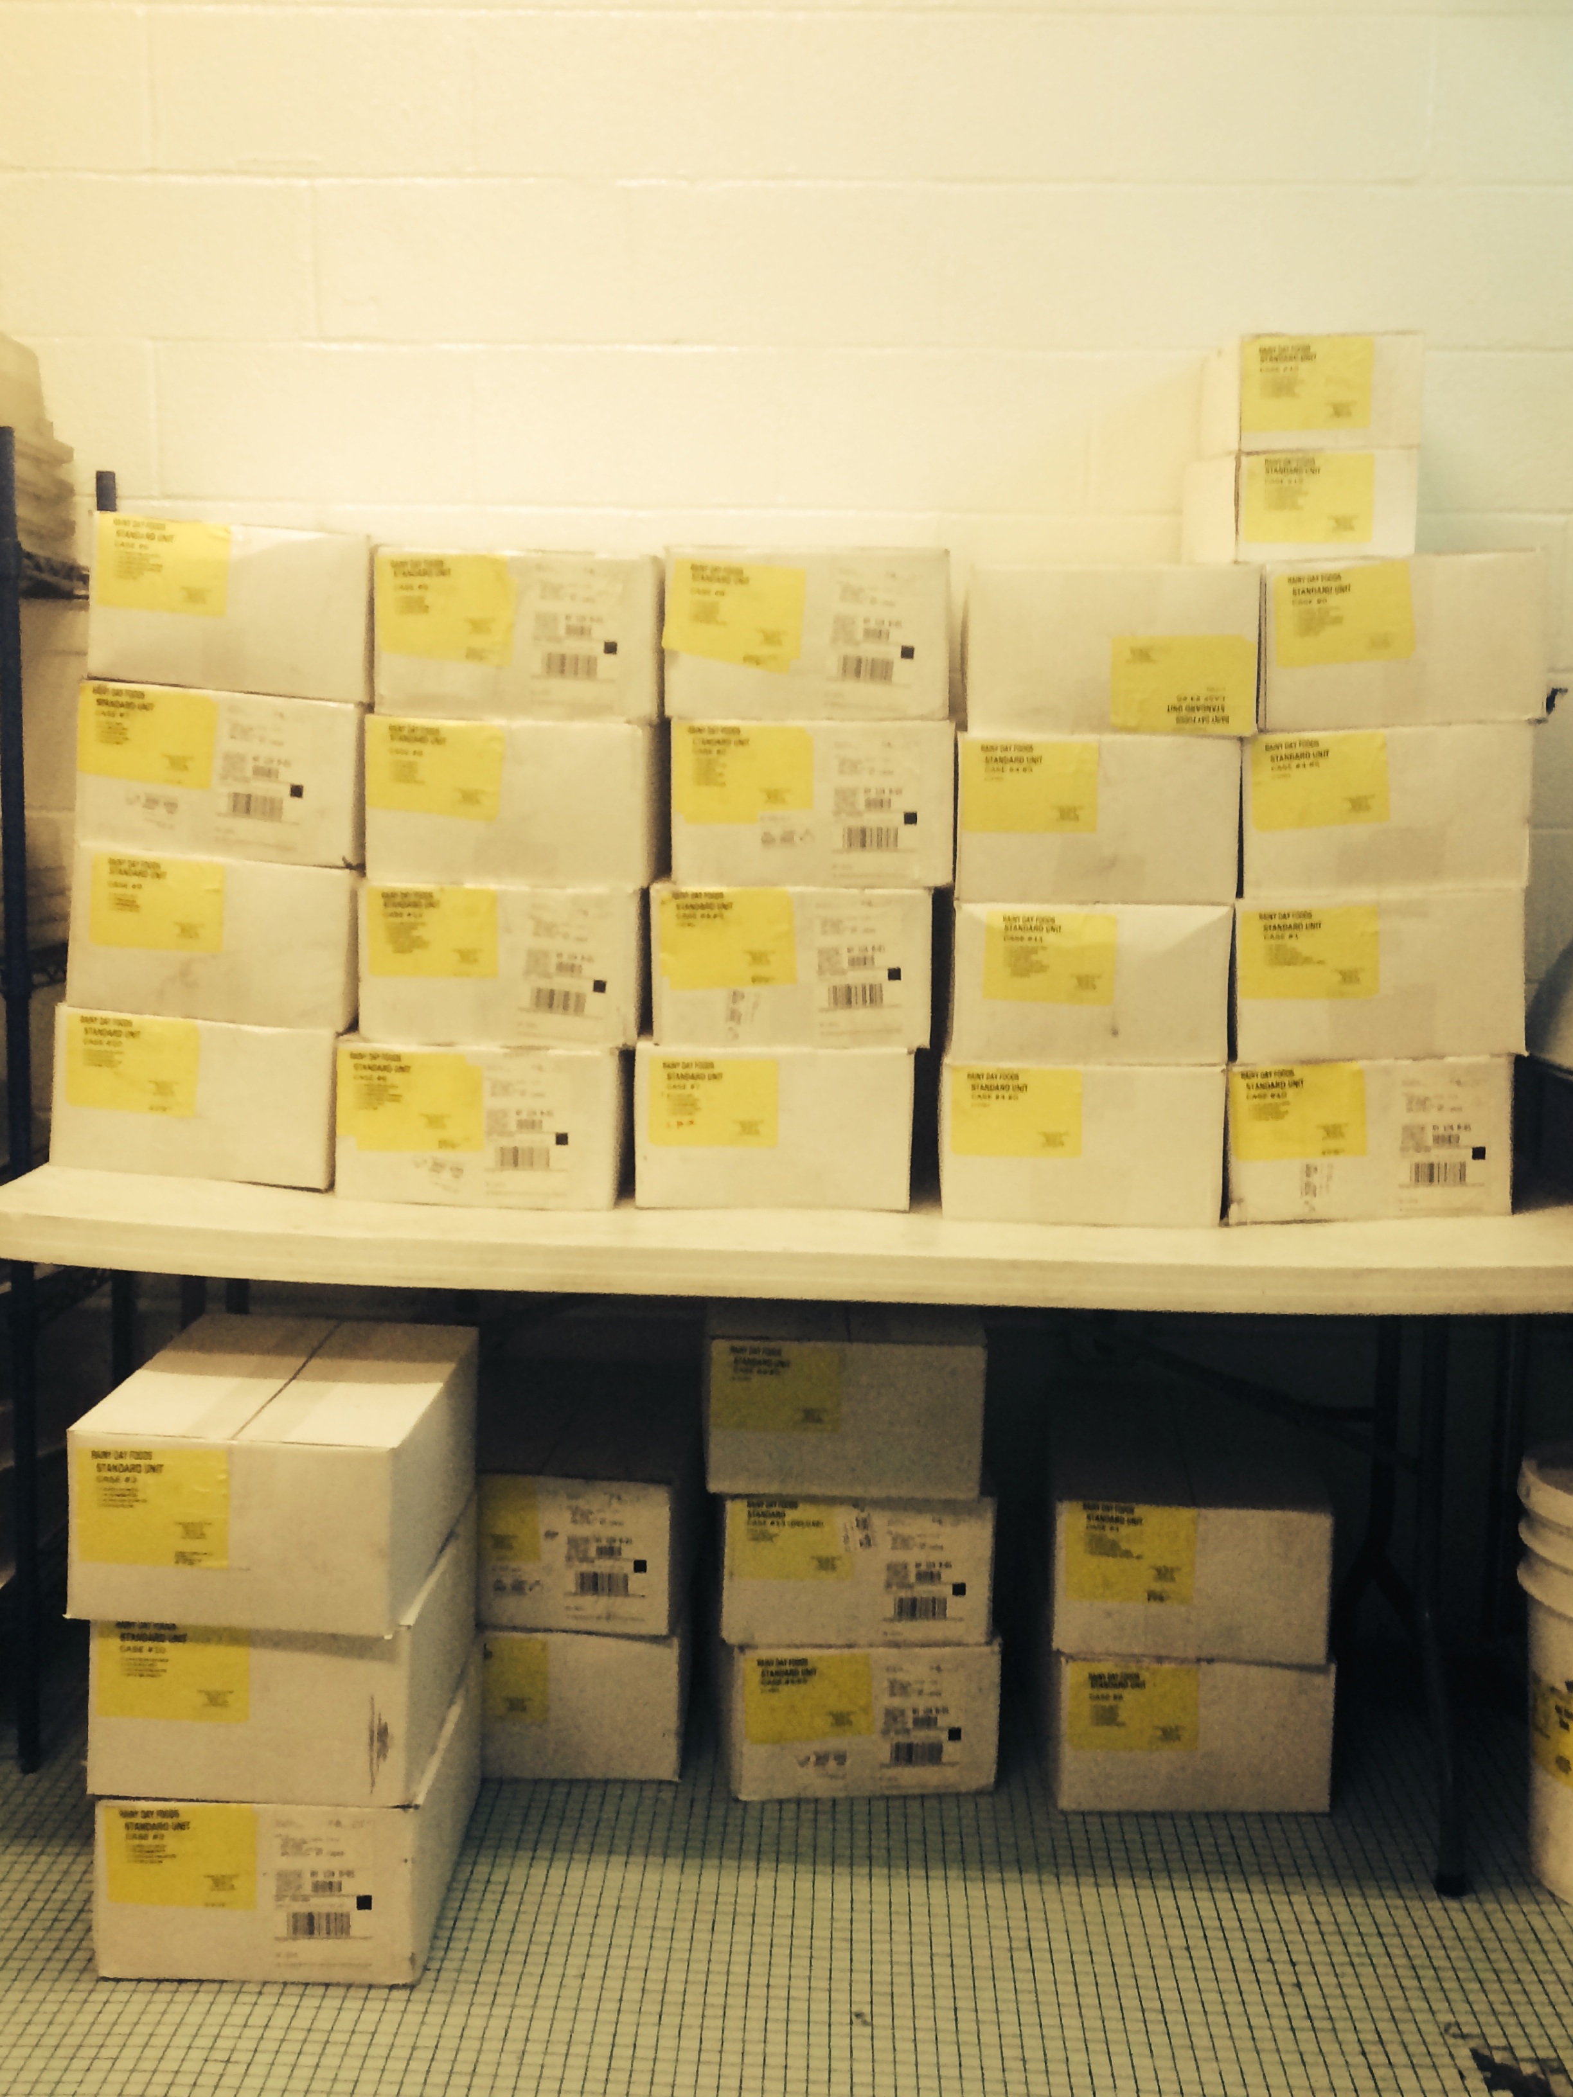
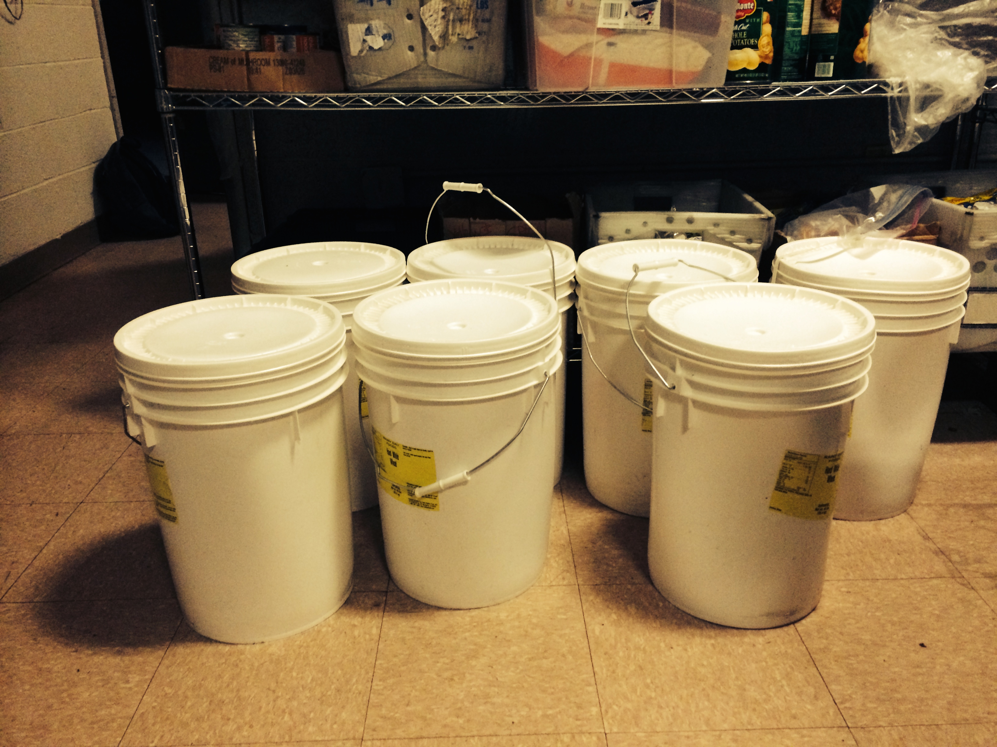
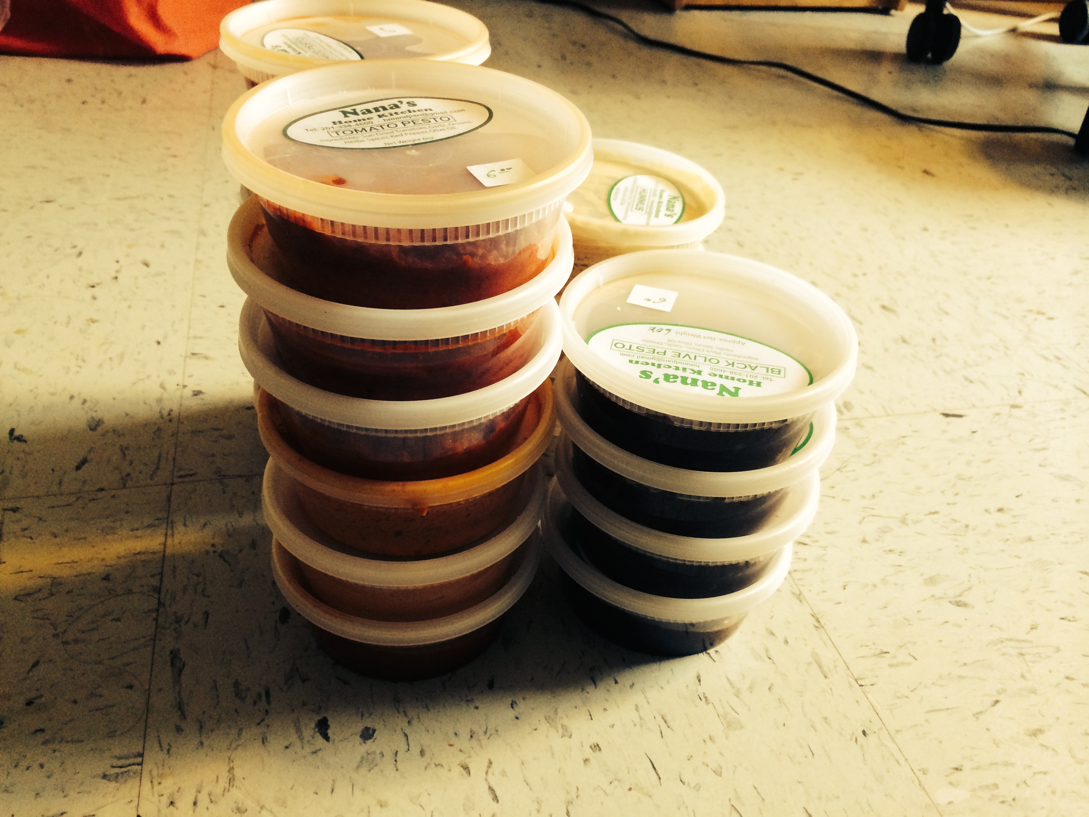
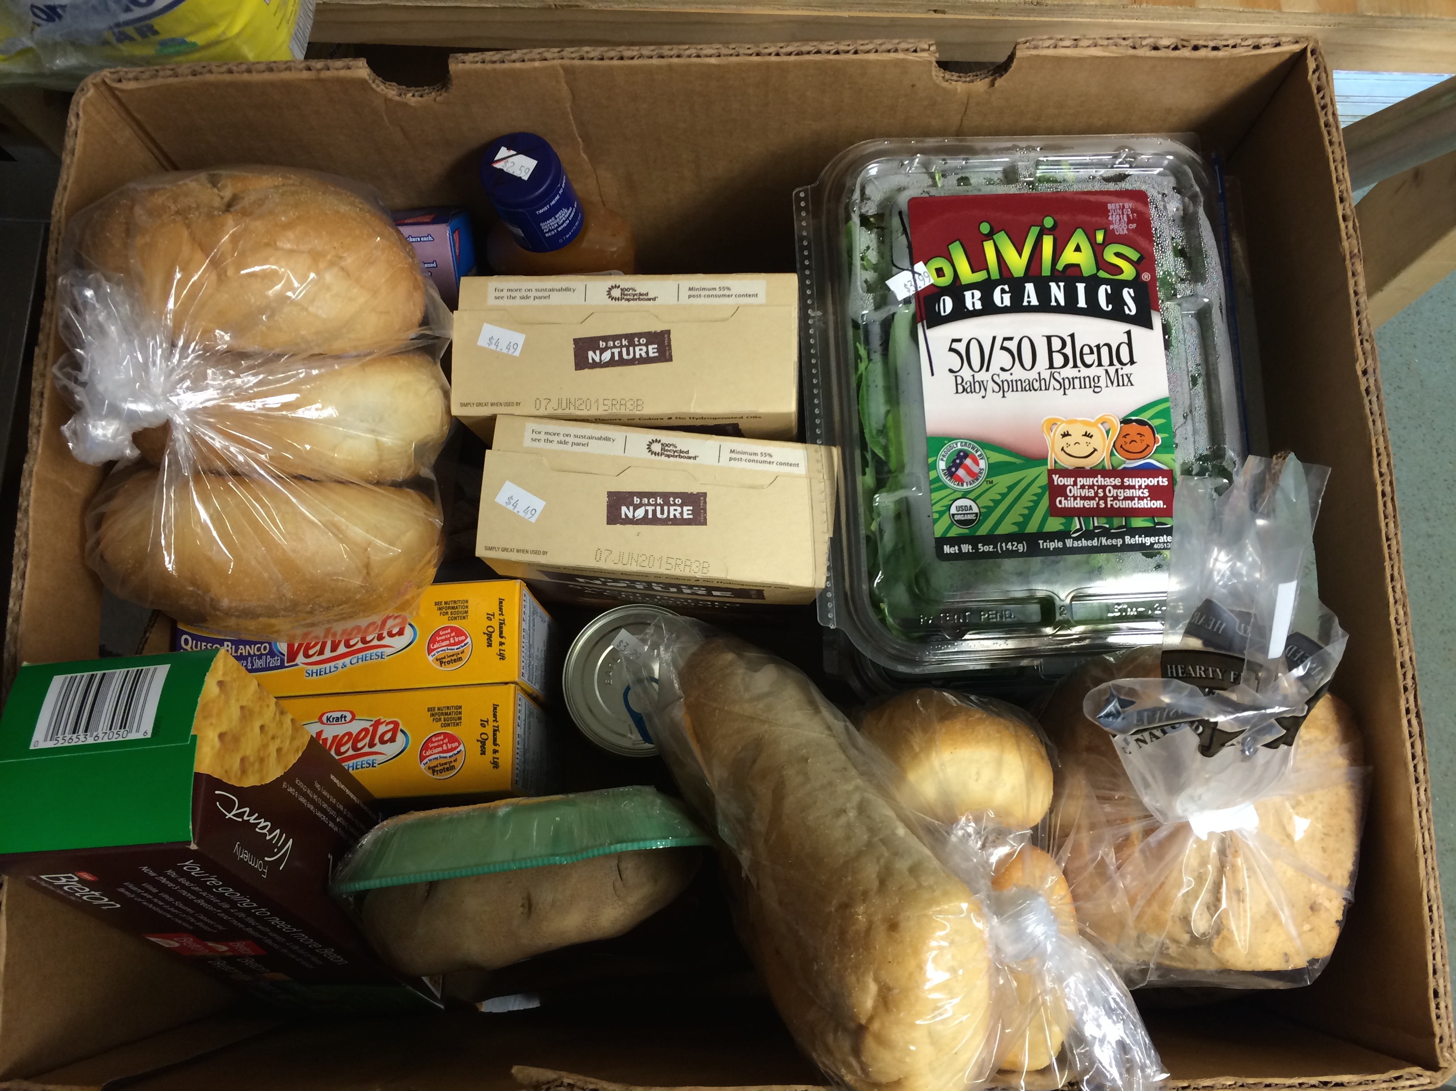
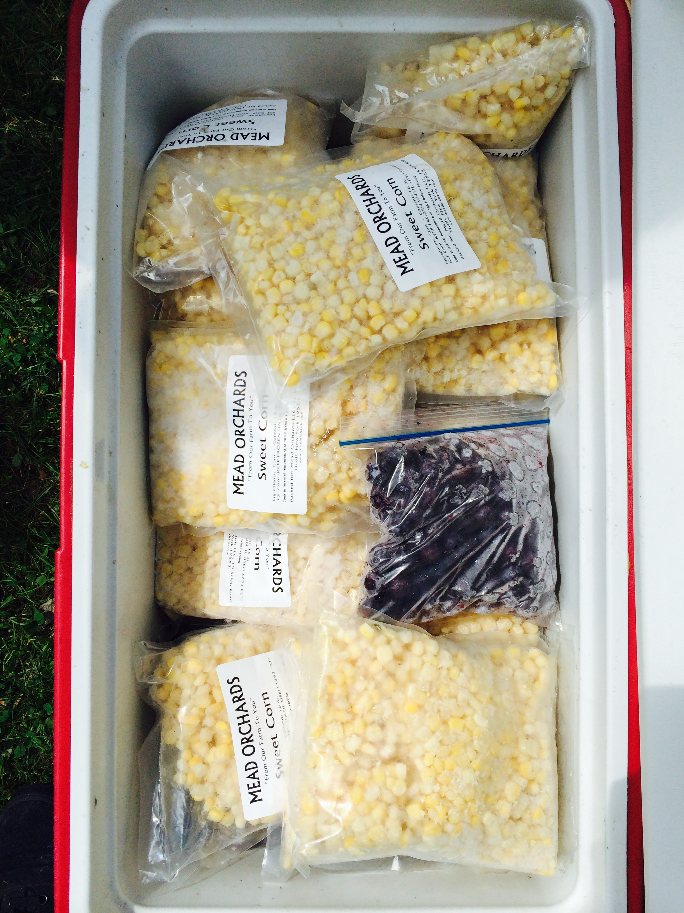
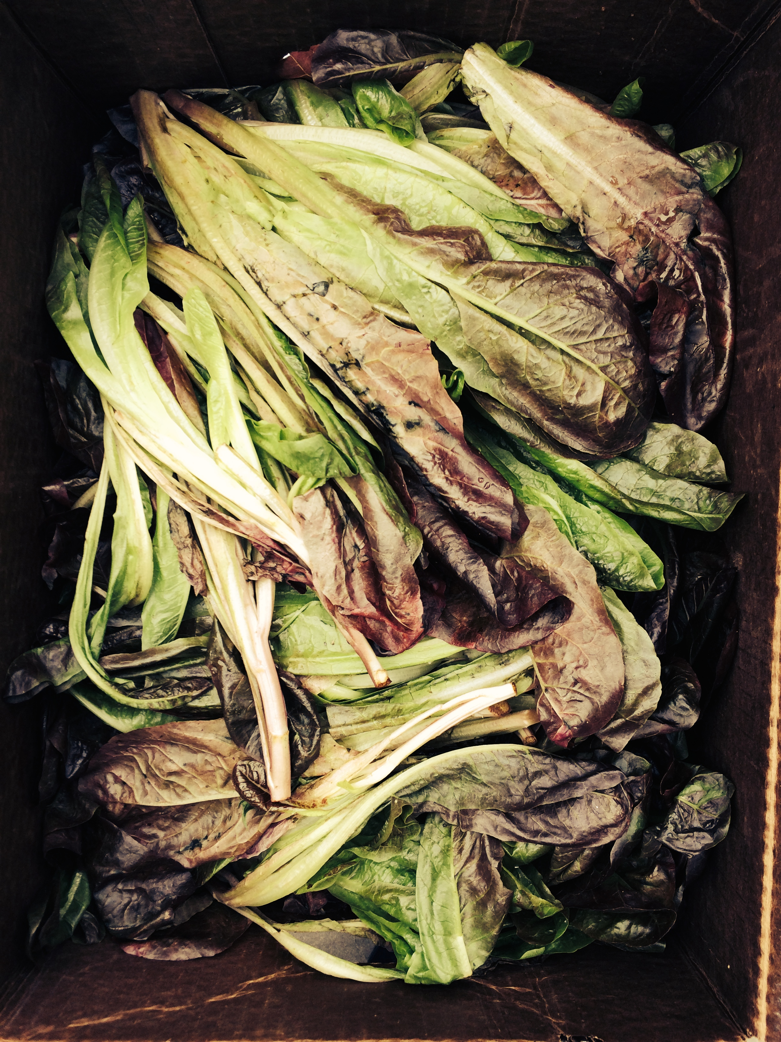
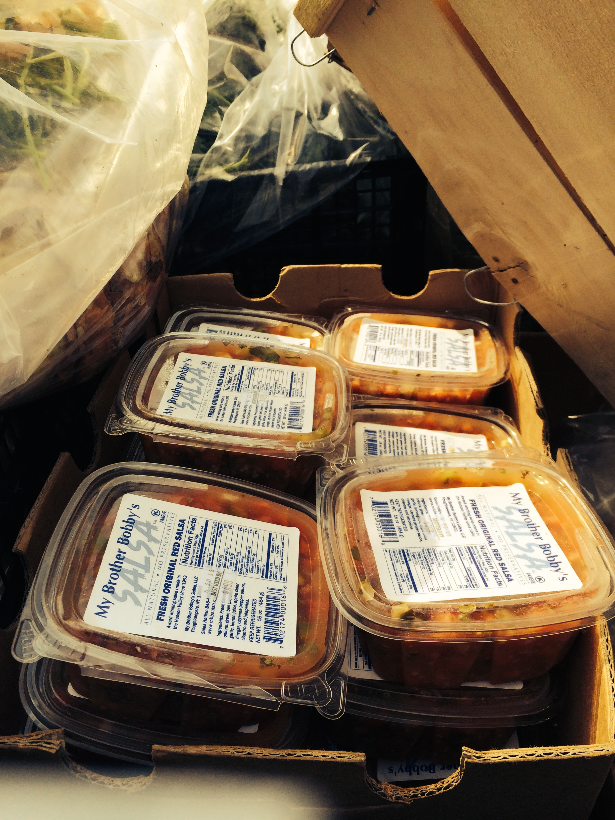
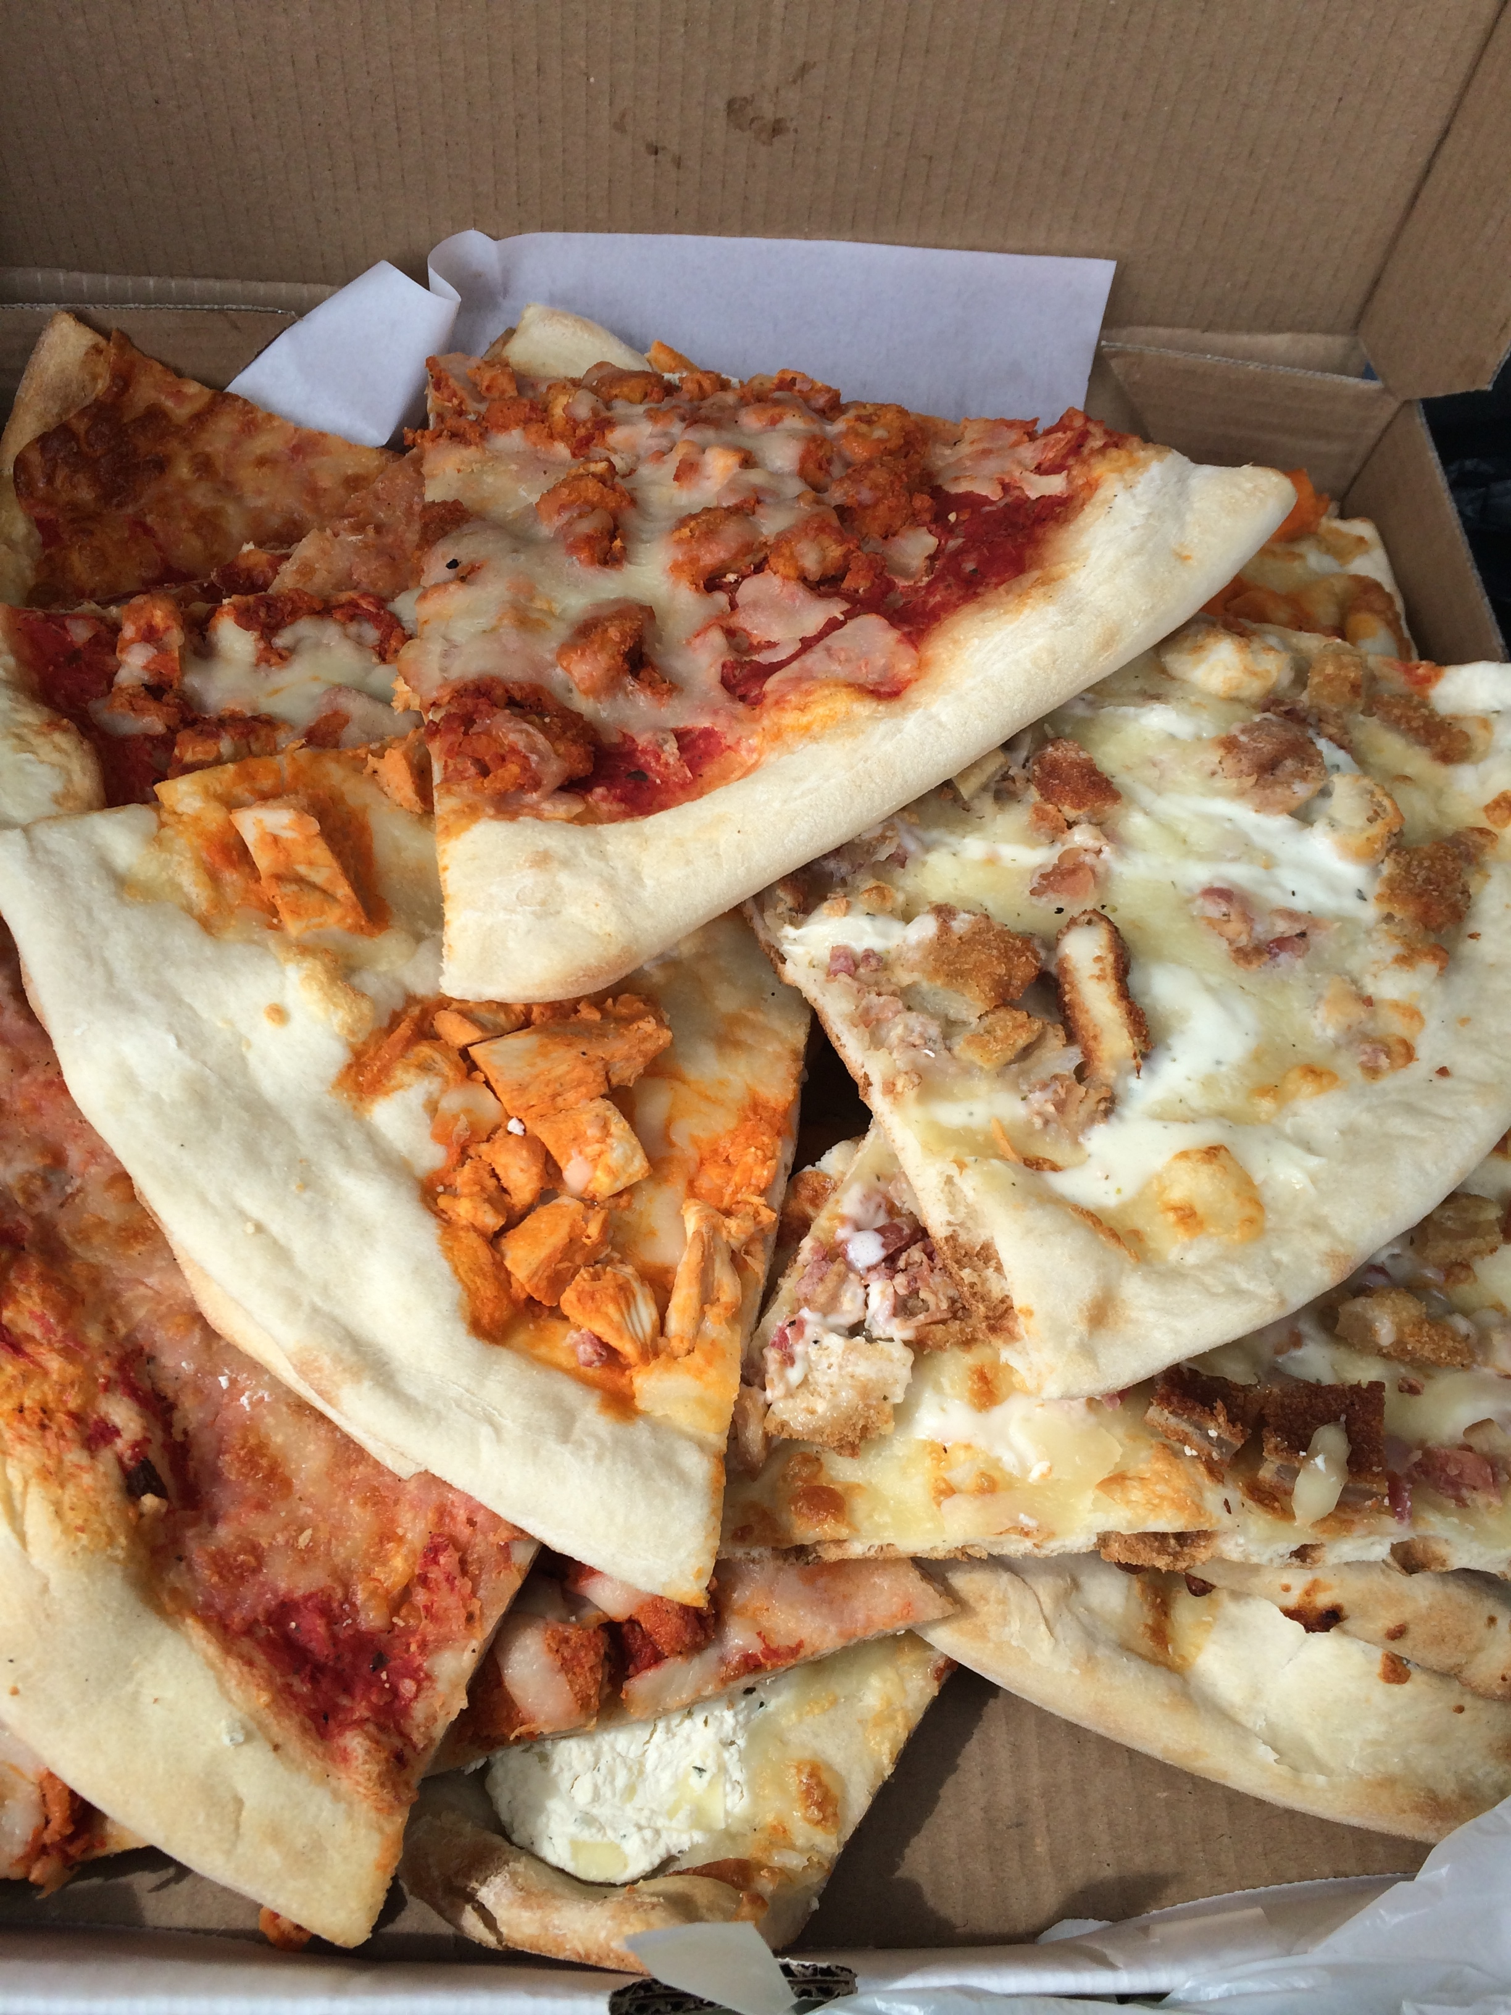

+ 22,000 pounds rescued since June 2015!
18,487 Meals Served.
7,150 tons CO2 Emissions Saved.

Slide 14
For more information..
siennah.yang@rescuingleftovercuisine.org
rescuingleftovercuisine.org
facebook.com/RLCinPoughkeepsie

