Slide 1



Climate Action Planning Institute Cohort Presentation
EXAMPLE Town Seal
NOTE – Please Remove all guidance or example text in Red
April, 2024
CAPI is a project of the Hudson Valley Regional Council and is funded by the DEC Climate Smart Communities Grant Program.
Notes:
DEC's Climate Smart Communities program is designed to support on-the-ground efforts to reduce climate-altering emissions, ramp up renewable energy generation, and strengthen local infrastructure," said Commissioner Seggos

Slide 2
Table of Contents
Emissions by sector
Emissions Reduction Goal(s) + Mitigation Objectives
List of Recommended Strategies (actions)
Lead Actor(s) and KPI(s) for a sample strategy or strategies
Co-Benefit(s) and Reduction Potential for a sample strategy
Reduction Measure Graph(s) from ClearPath
Implementation Timeline
Draft Vision Statement
Public Outreach
Next Steps

Slide 3
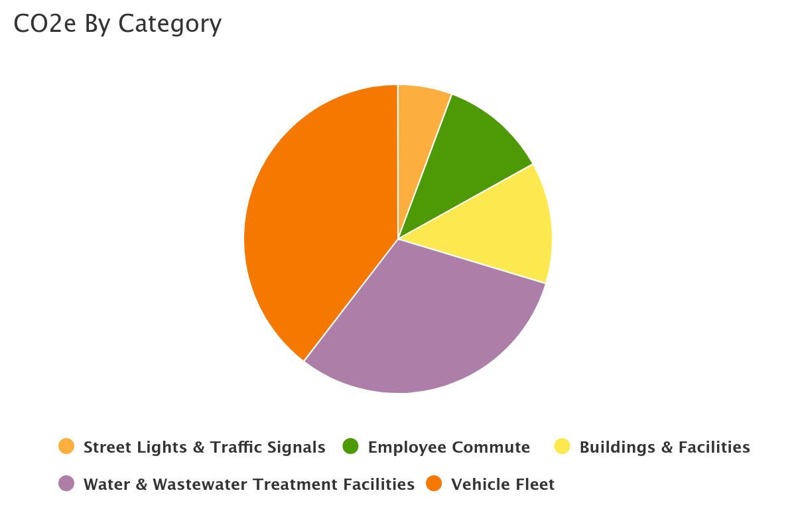
1.Emissions Sector Pie from GHG Inventory
EXAMPLE
Replace with link to GOGHGI Emissions report on municipal web site
Notes:
https://hudsonvalleyregionalcouncil.org/capi/

Slide 4
2. GHG Emissions Reduction Goal + Mitigation Objectives
SAMPLE TEXT: Town of XX has chosen to align its reduction goals with statewide goals. The Climate Leadership and Community Protection Act (CLCPA), signed into law on July 18, 2019, sets goals to reduce emissions to 40% below 1990 levels by 2030 and then to 85% below 1990 levels by 2050. When modeled in ClearPath, the emissions forecasting and reduction modeling software utilized by Town of Amenia, these percentages were further modified to 33% and 78%, given the energy reduction improvements New York State has already made to the grid since 1990.
EXAMPLE

Slide 5
3.Recommended Strategies Overview
List All Strategies. Delete sectors that don’t apply
Strategy #1 | Buildings and Facilities:
Strategy #2 | Buildings and Facilities:
Strategy #3 | Vehicle Fleet:
Strategy #4 | Vehicle Fleet:
Strategy #5 | Employee Commute:
Strategy #6 | Street Lights & Traffic Signals:
Strategy #7 | Water and Wastewater Treatment Facility:
Strategy #8 | Natural Resources:

Slide 6
4. Lead Actors and Success Metrics / KPIs
Strategy Number | Strategy | Lead Actor / Owner | Metric / KPI
T1-A | Right-size fleet: Create a vehicle pool to more effectively use and increase turnover of non-emergency vehicles | Village Manager | Total # of vehicles Departmental vehicles eliminated
T1-B | Replace sheriff patrol vehicles with hybrid pursuit rated sedans Go from 12.9 to 34 mpg $209,000 annual fuel savings fleetwide Estimated 4 year payback of initial cost difference | Police Dept | # of electric vehicles # of plug-in hybrid vehicles
EXAMPLE
Note – Pick 1-3 highest priority strategies / actions to highlight

Slide 7





Reminder of Strategy Co-Benefits
Cost / Saving Money
Enhancing Resource Security
Reduce energy system strain as transition to renewable energy.
Creating Jobs
Improving Public Health
Delivering Benefits to Frontline Communities
Address vulnerable communities
Notes:
2. For example, extreme and prolonged heat waves can put considerable strain on the reliability of energy delivery in peak periods, possibly leading to service disruption during times when cooling is most needed. Diversifying energy sources, such service disruptions are less likely and [Jurisdiction] will be able to better cope with those situations.
5. vulnerable populations such as the elderly or chronically ill, low income families and people of color are more at risk when it comes to experiencing impacts of climate change.

Slide 8

5. Co-Benefits and Reduction Potential
Objective | Strategy | C0-Benefits | Reduction Potential
T1: Improve energy efficiency of government buildings | Upgrade HVAC equipment (Convert Facilities Space Heating to Heat Pumps)
T1: Improve energy efficiency of government buildings | Conduct Energy Audits of Government Buildings and implement recommendations (Retro-Commissioning)
T1: Improve energy efficiency of government buildings | Reassess and maintain current heating system
T1: Improve energy efficiency of government buildings | Install light occupancy sensors
EXAMPLE
Note – Pick 1-3 highest priority strategies / actions to highlight

Slide 9
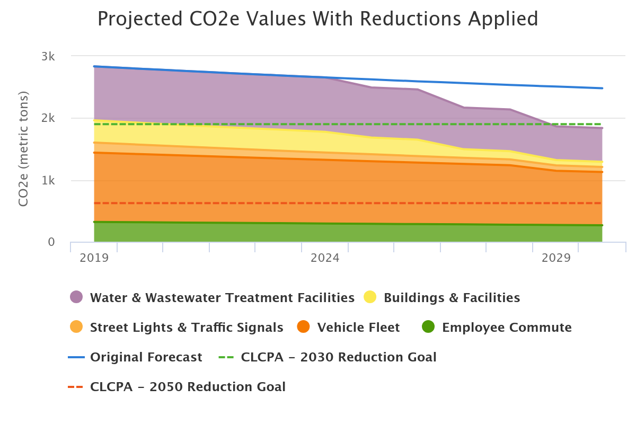
6. Reduction Measures Graphs from ClearPath
EXAMPLE
Choose 1-2 highest priority strategies / actions to highlight
OPTIONAL SAMPLE TEXT: By electrifying the vehicle fleet, upgrading wastewater pumps, and switching to heat pumps in the community center, the Town surpasses the 2030 CLCPA reduction goal of 40%.
Notes:
This model is showing what would happen if solar panels were installed on half of the landfill’s area.

Slide 10
7.Implementation Plan with Priorities / Timeline
Sector | Recommended Strategy | 2024 | 2025 | 2026 | 2027 | 2028 | 2029 | 2030
Buildings and Facilities | Transition to heat pumps in the Town Hall DPW, and community Center* |  | X | X | X
Vehicle Fleet / Transportation | Adopt Env Preferred Purchasing Policy | X
Employee Commute | Conduct employee commute survey | X |  | X |  | X |  | X
Solid Waste | Implement recycling and composting program in Village Hall |  |  | X | X | X
Water and Wastewater Treatment Facilities | Upgrade water and wastewater facility pumps |  |  |  | X | X | X | X
EXAMPLE
Note – Pick 1-3 highest priority strategies / actions to highlight

Slide 11
8.Draft Vision Statement
SAMPLE Vision Statement: Aggressively transition toward clean, carbon-free technologies and infrastructure upgrades that improve health, livability and resilience of the Village's community to mitigate and adapt to the impacts of climate change.
See more on visioning: CAPI Adapt Visioning – Hudson Valley Regional Council (PW CAPI-A)
For communities participating in CAPI Adapt, the draft vision statement should include both mitigation and adaptation. Also, remember to track meetings where the vision statement was presented, and note any/all community feedback related to the vision statement. Creating a community climate adaptation and resilience vision statement is valued at 3 pts under PE 7: Climate Adaptation Plan.
Notes:
https://hudsonvalleyregionalcouncil.org/capi/

Slide 12
9.Public Outreach: Key Stakeholder Meetings
Meeting Name | Date | Stakeholders
City Council | December 2023 | Cite Council, Mayor and members of the public
Internal Staff Meeting | January 2024 | All municipal managers
Climate Smart Communities Task force | February 2024 | CSC Task Force, members of the public
Conservation Advisory Committee | March 2024 | CAC Members
OPTIONAL /
EXAMPLE
For CSC, it’s mandatory a link is provided to the draft GOGHGI AND GOCAP on municipal web site along w/email address for public comments / input. For example: gocapfeedback@gmail.com.
12

Slide 13
Optional - Outreach addressing Climate Equity an/or Disadvantaged Communities
Group Name | Type of Outreach | Stakeholders
Senior Council | Email to Council soliciting feedback with link to the Plan | Senior citizens who are often most affected by climate change.
Youth Council | Email to Council soliciting feedback with link to the Plan | Youth who are often most affected by climate change.
Affordable Housing Committee | February 2024 | Equity issues associated with lack of affordable housing
OPTIONAL /
EXAMPLE
EXAMPLE
13

Slide 14
10. Remaining Tasks - Next Steps
For CAPI
Date GOCAP posted to municipal website: March 30, 2024
Estimated date for presenting GOCAP to local government: May 2024
Optional: Date GOCAP made available at a local library: May 2024
Additional Next Steps for CSC
Estimated date for local government officially adopting GOCAP: June 2024
Estimated date GOCAP uploaded to CSC portal: June 2024
Estimated date to begin GOCAP Implementation: July 2024
EXAMPLE

Slide 15
Acknowledgements / Thanks
Thanks to the Mayor / Supervisor, municipal; staff, CAPI team, volunteers, residents, etc.
If you choose to also thank ICLEI, HVRC and the CAPI cohort, you may want to call out some aspects of the program to date that you found most helpful, i.e. the focus on creating and documenting a process, which will facilitate producing the next version of the CAP; ICLEI’s CAP template; or leveraging the collective wisdom of other municipalities in your CAPI cohort.
Required grant language:
CAPI is a program of the Hudson Valley Regional Council. This program has been funded in part through a grant to the County of Dutchess as lead applicant through the Climate Smart Communities Grant Program, Title 15 of the Environmental Protection Fund through the New York State Department of Environmental Conservation.”

Slide 16
Thank You
<NAME>
(Email)

