Slide 1
Why Grid Batteries?
Jeff Seidman
Vassar College
jeseidman@vassar.edu

Slide 2

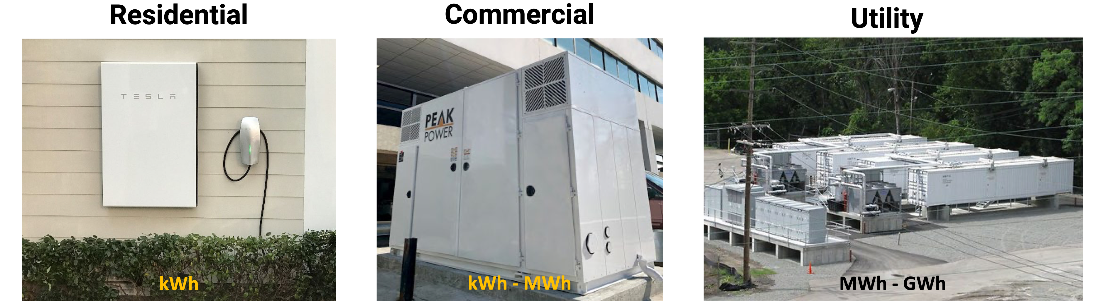
Battery Systems

Slide 3
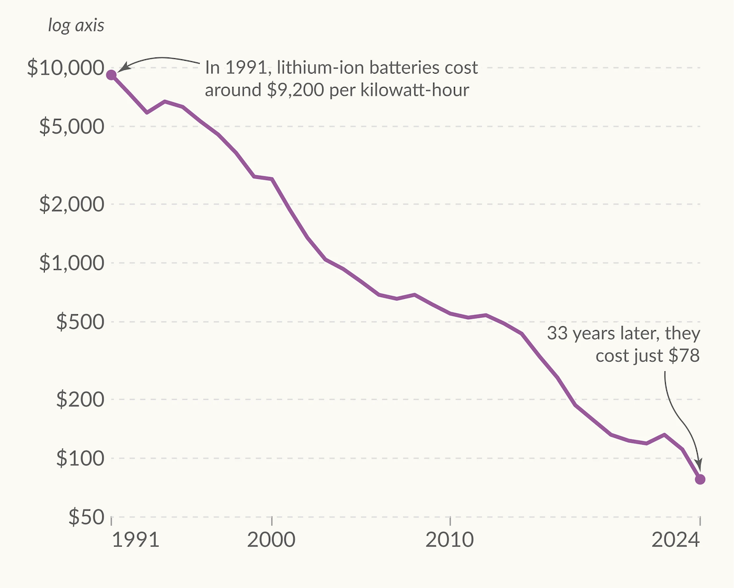
Battery costs are plummeting

Slide 4
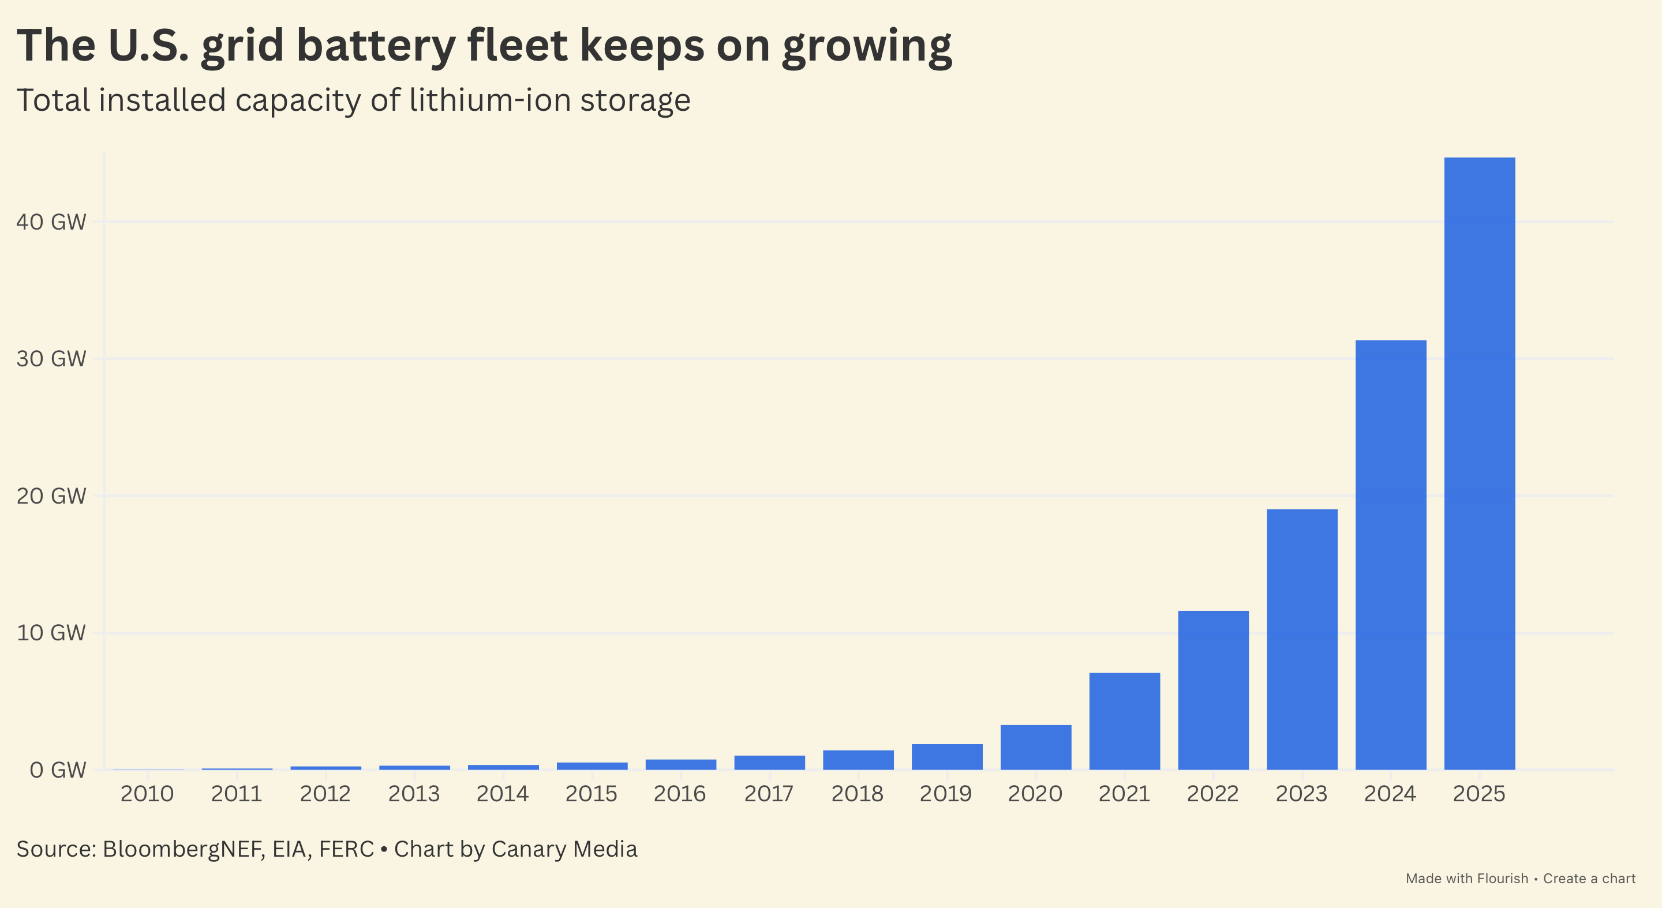
Grid-scale battery deployment is growing exponentially, in the U.S. and around the globe

Slide 5
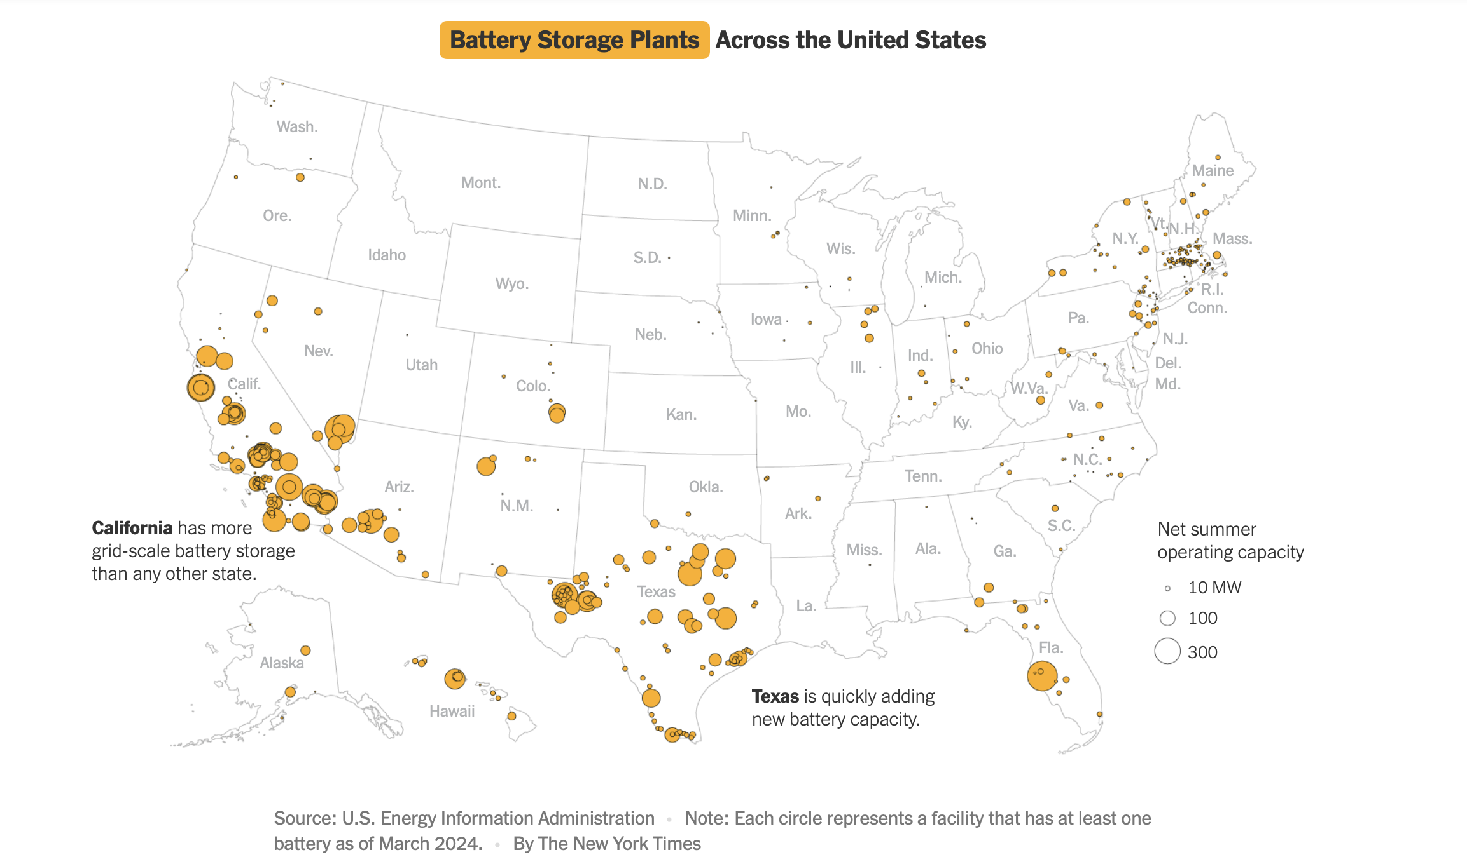

Slide 6
Why do grid-operators want batteries?
Economics
+
Resilience

Slide 7
1. Access to cheaper power

Slide 8
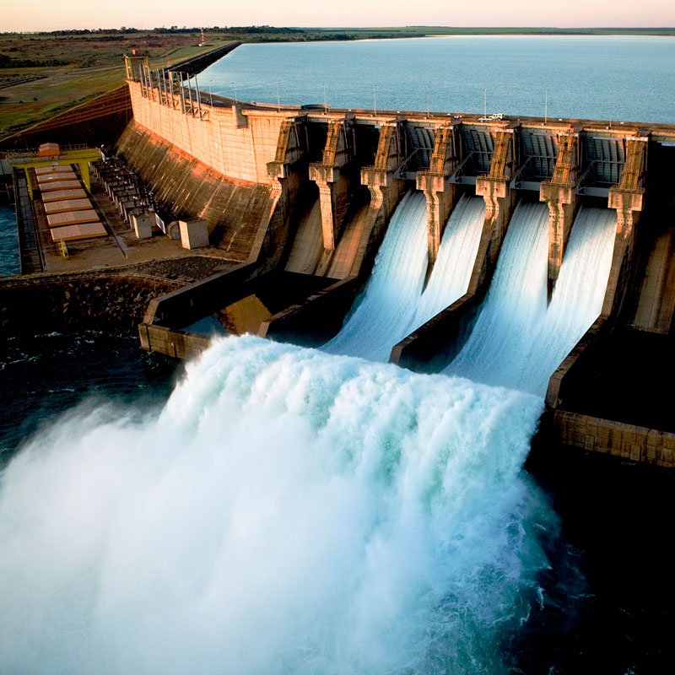
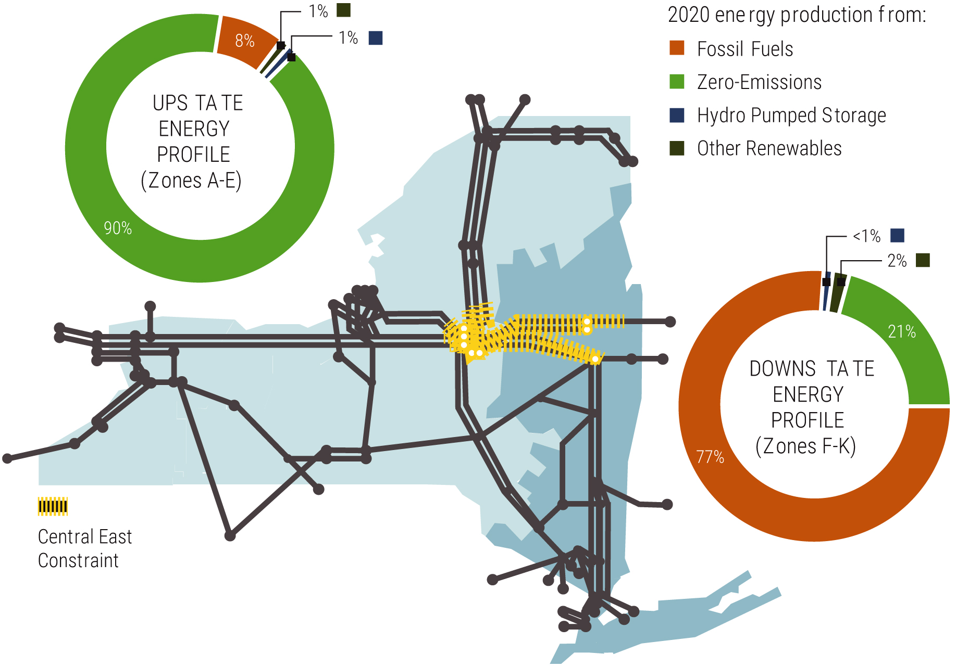
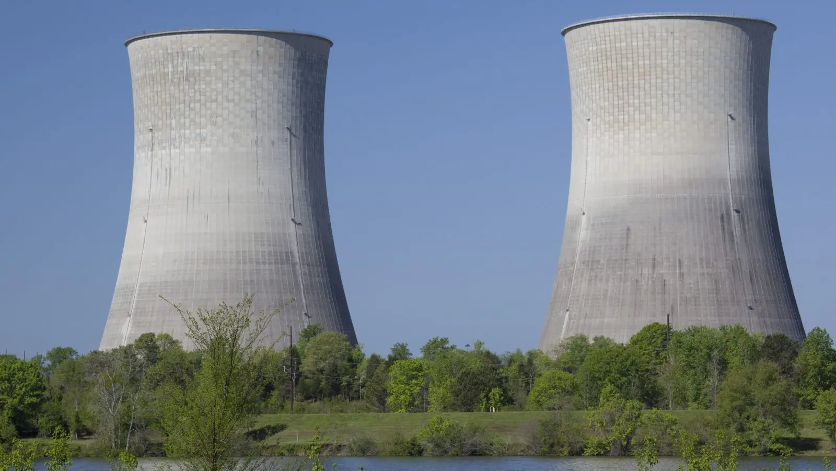
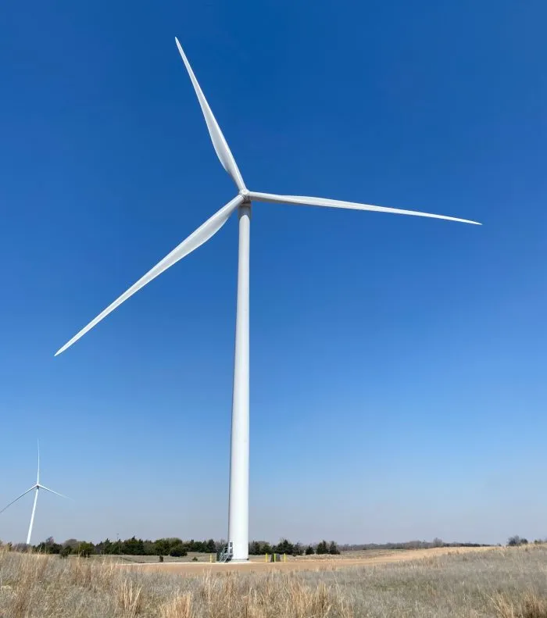
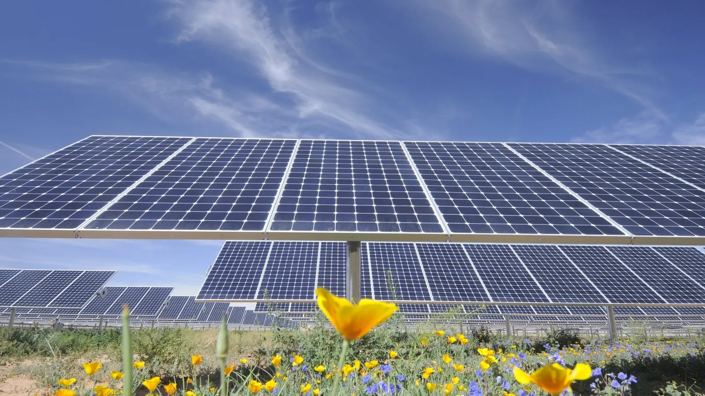



New York: “A Tale of 2 Grids”

Slide 9
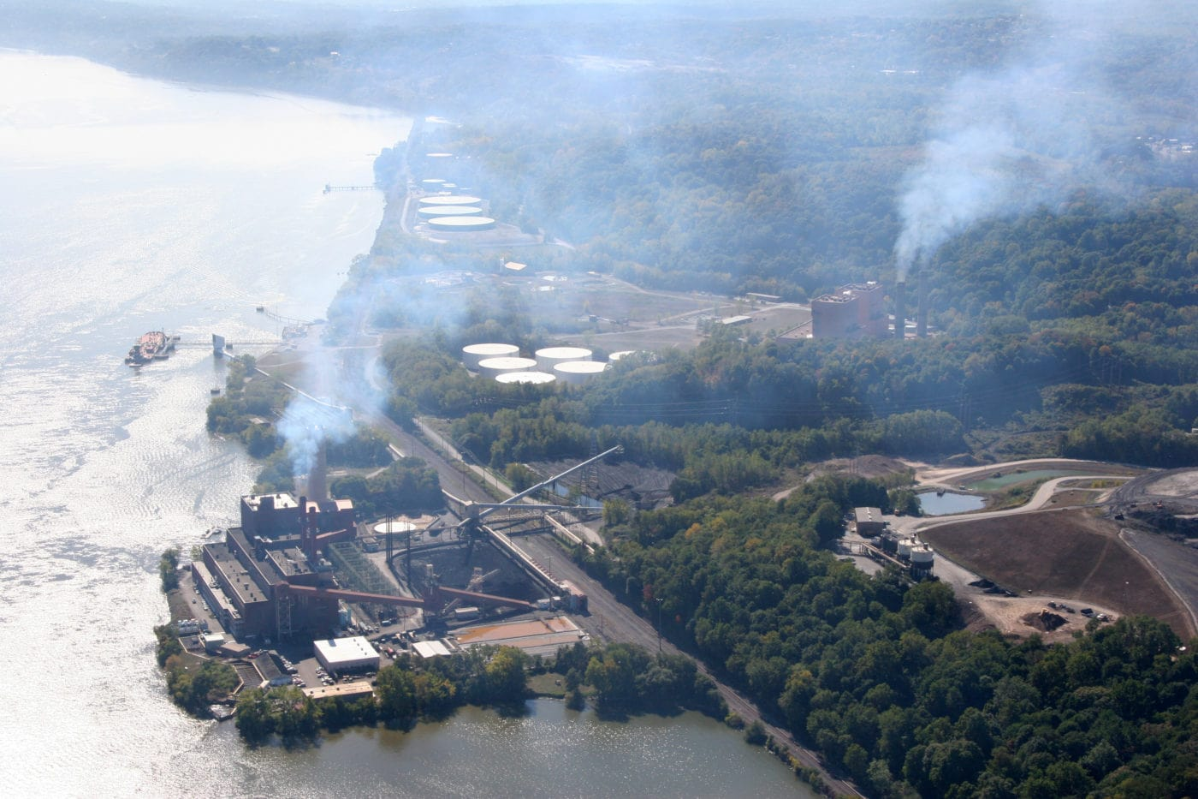
Danskammer dual-fuel (gas and oil) “Peaker” Plant

Slide 10
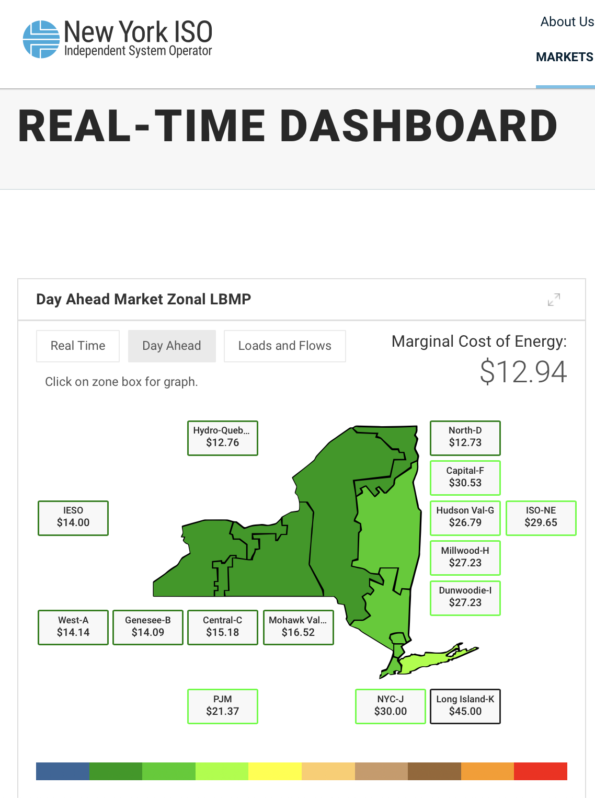


Slide 11

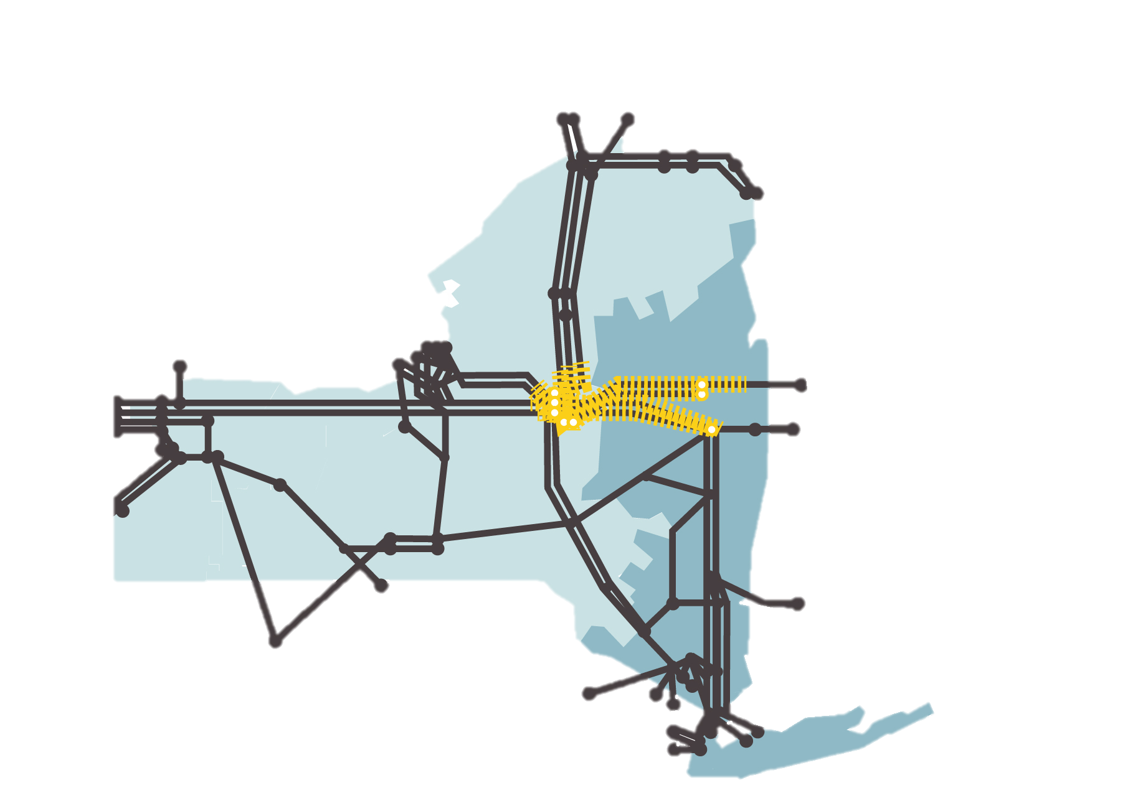

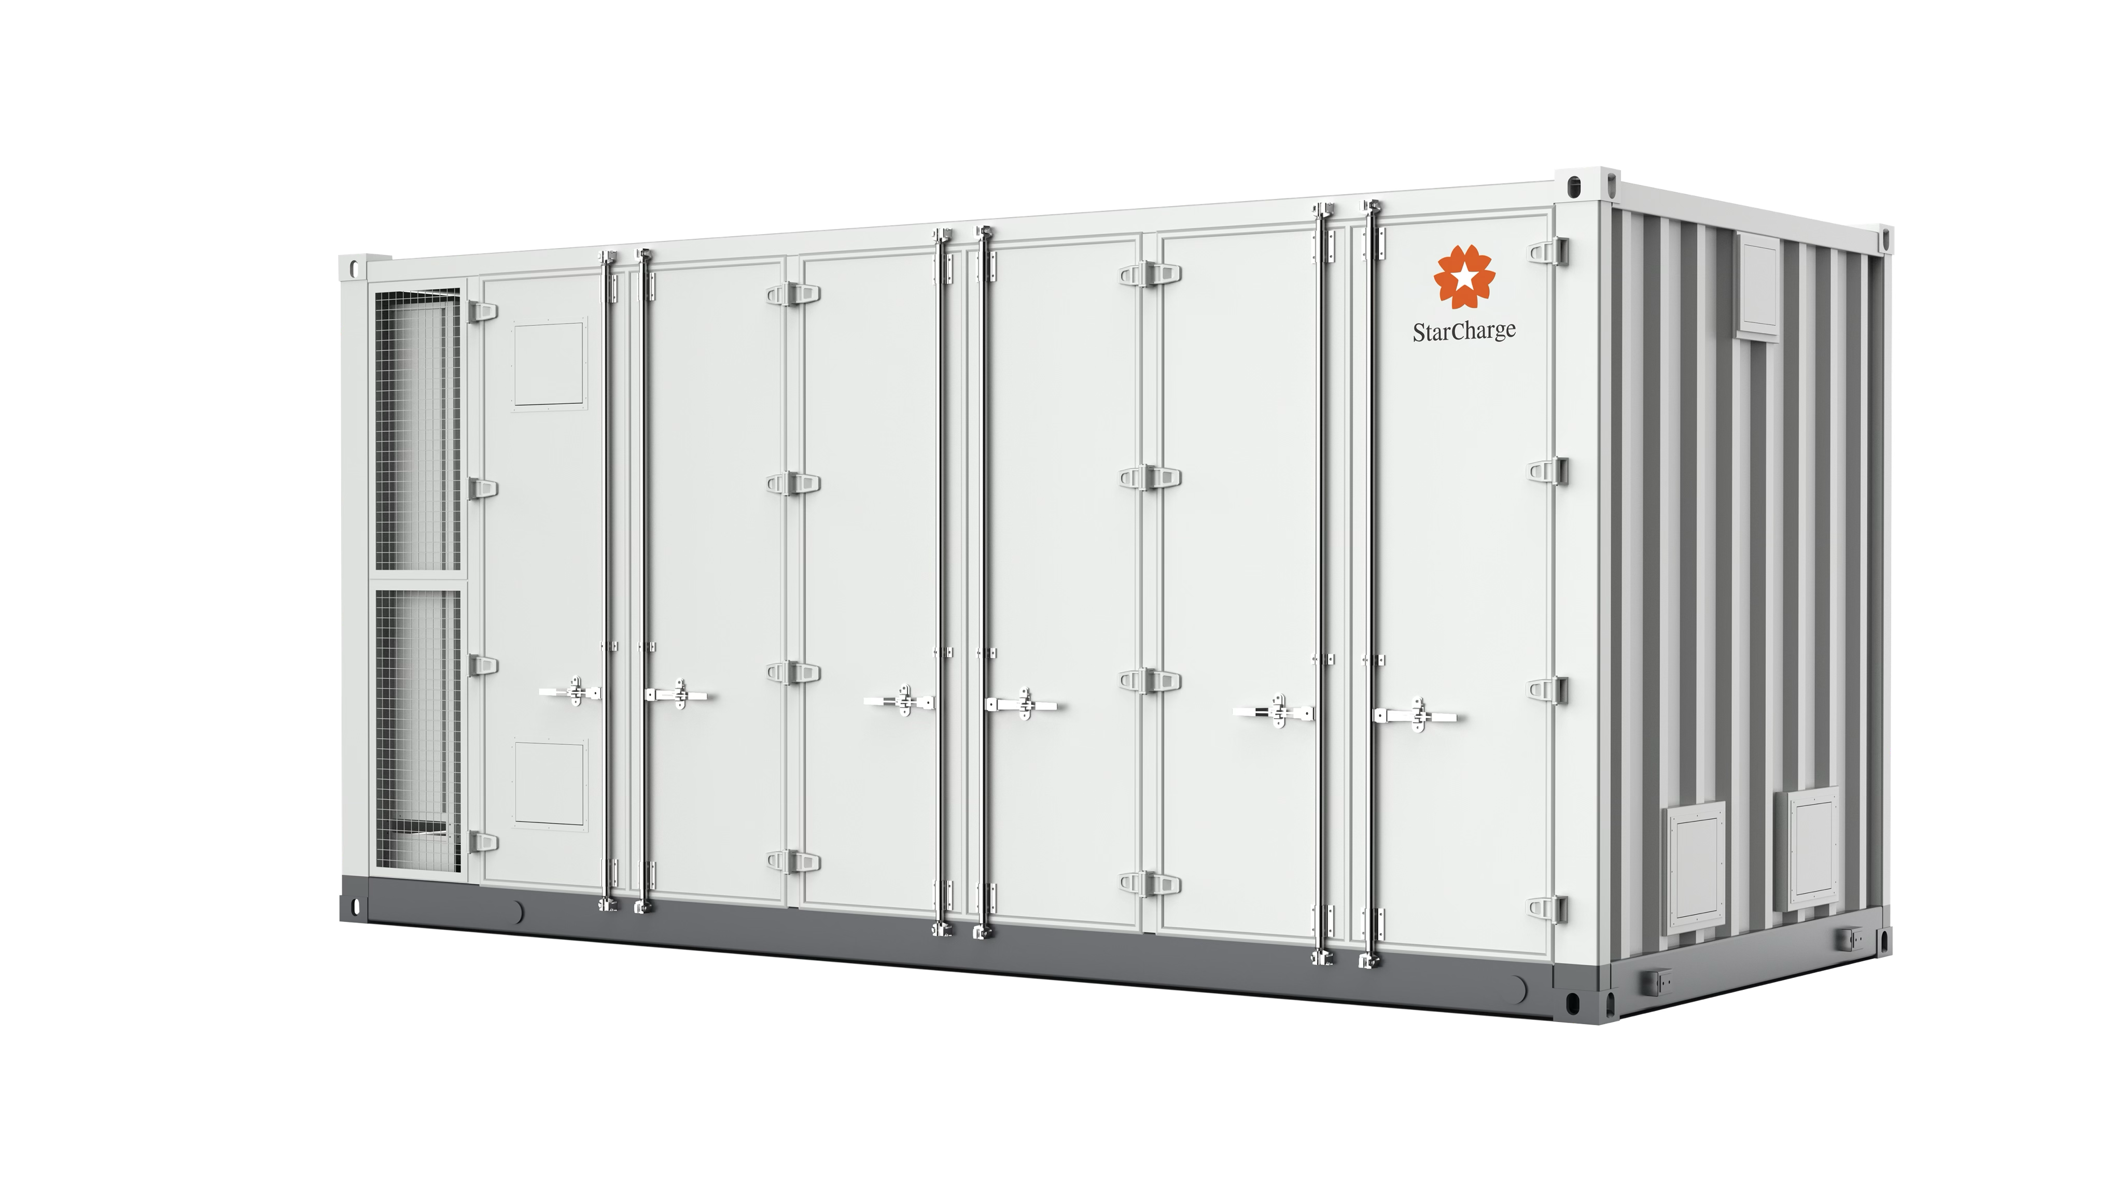

Slide 12


Slide 13
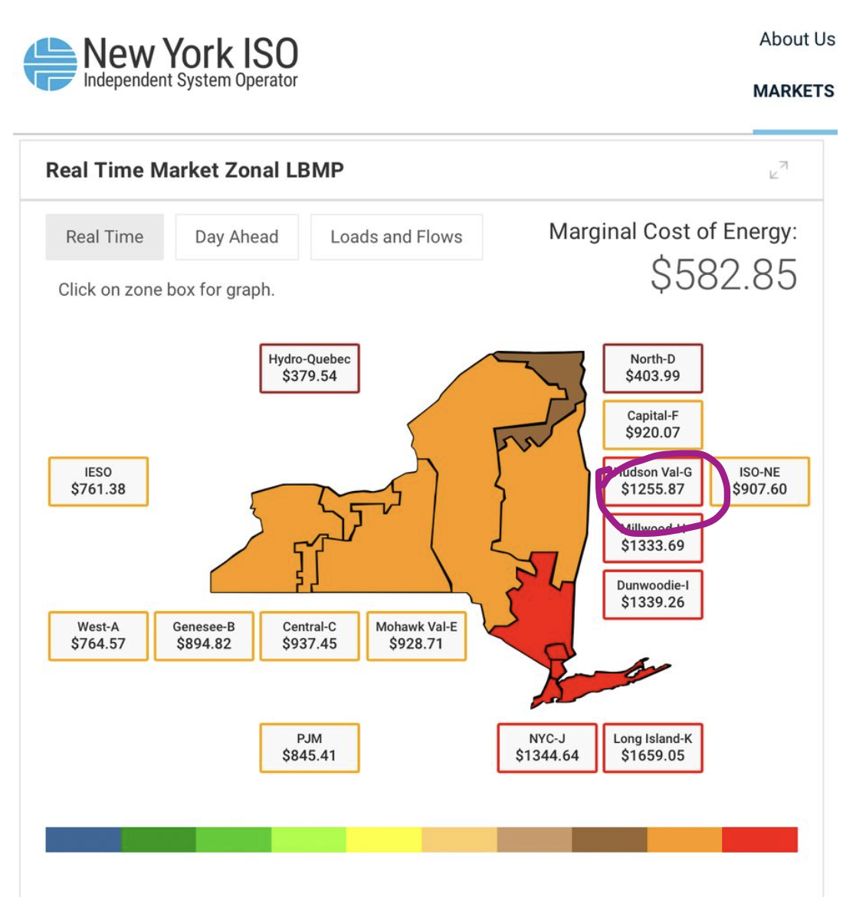
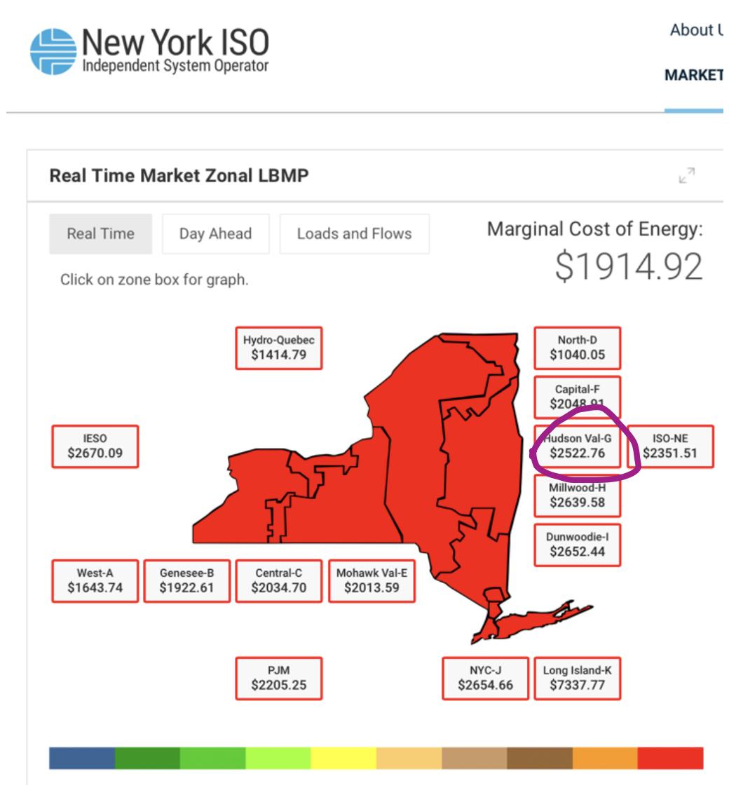
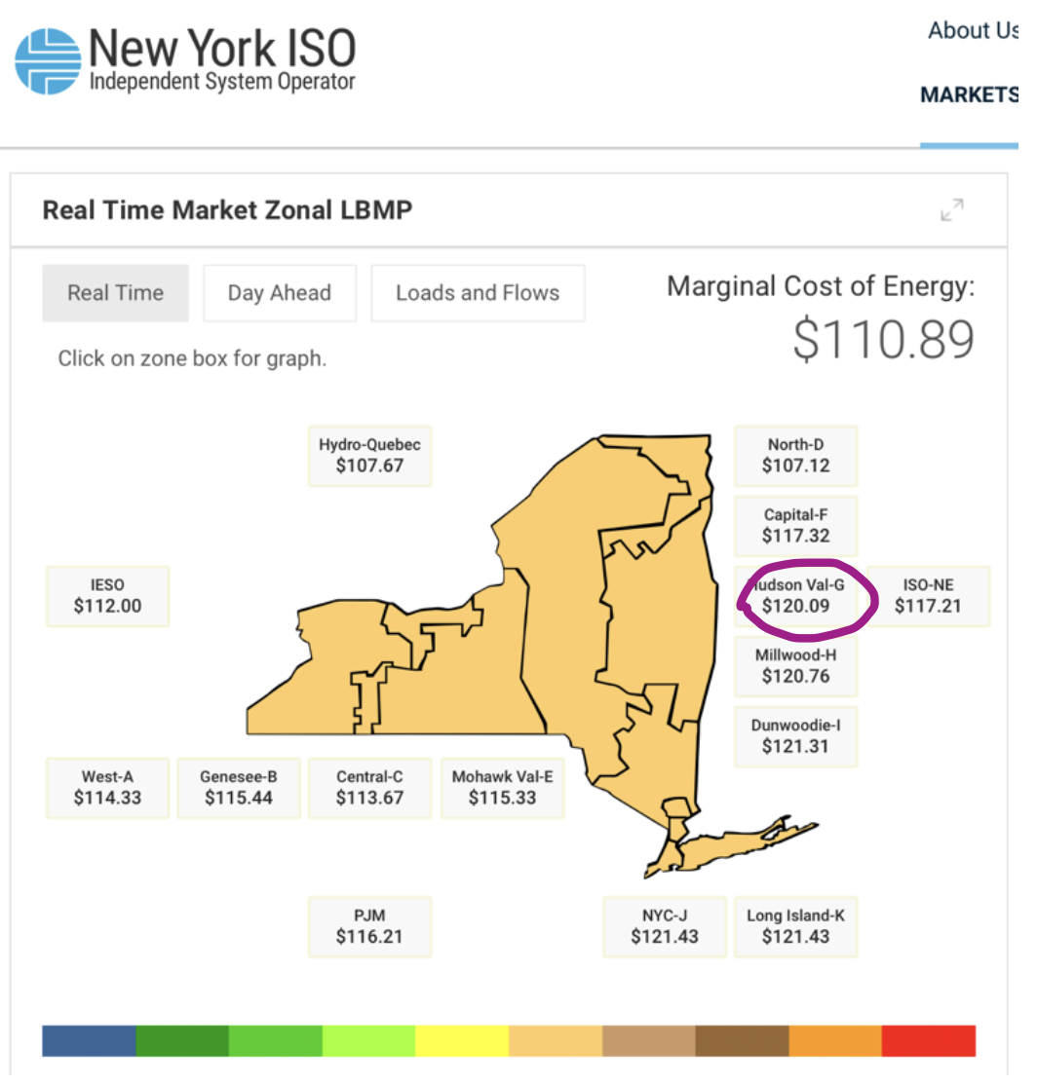
June 24, 2025
10:32 AM
3:40 PM
5:57 PM

Slide 14
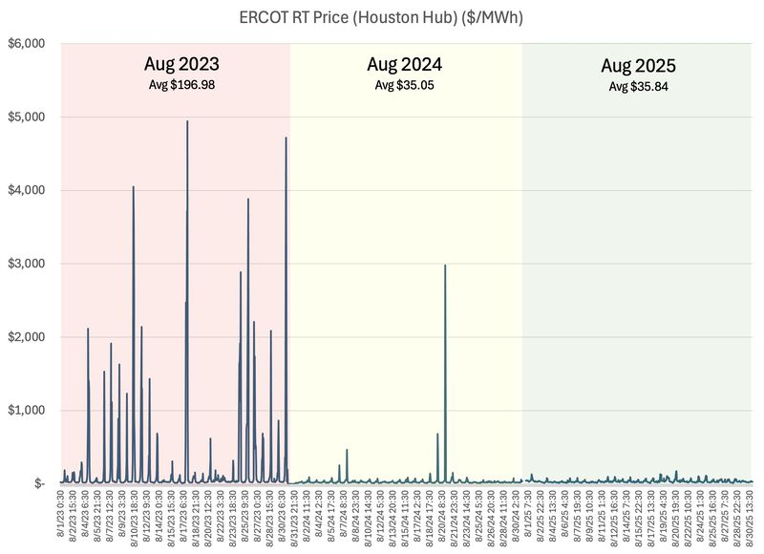
Texas tamed its price spikes…

Slide 15
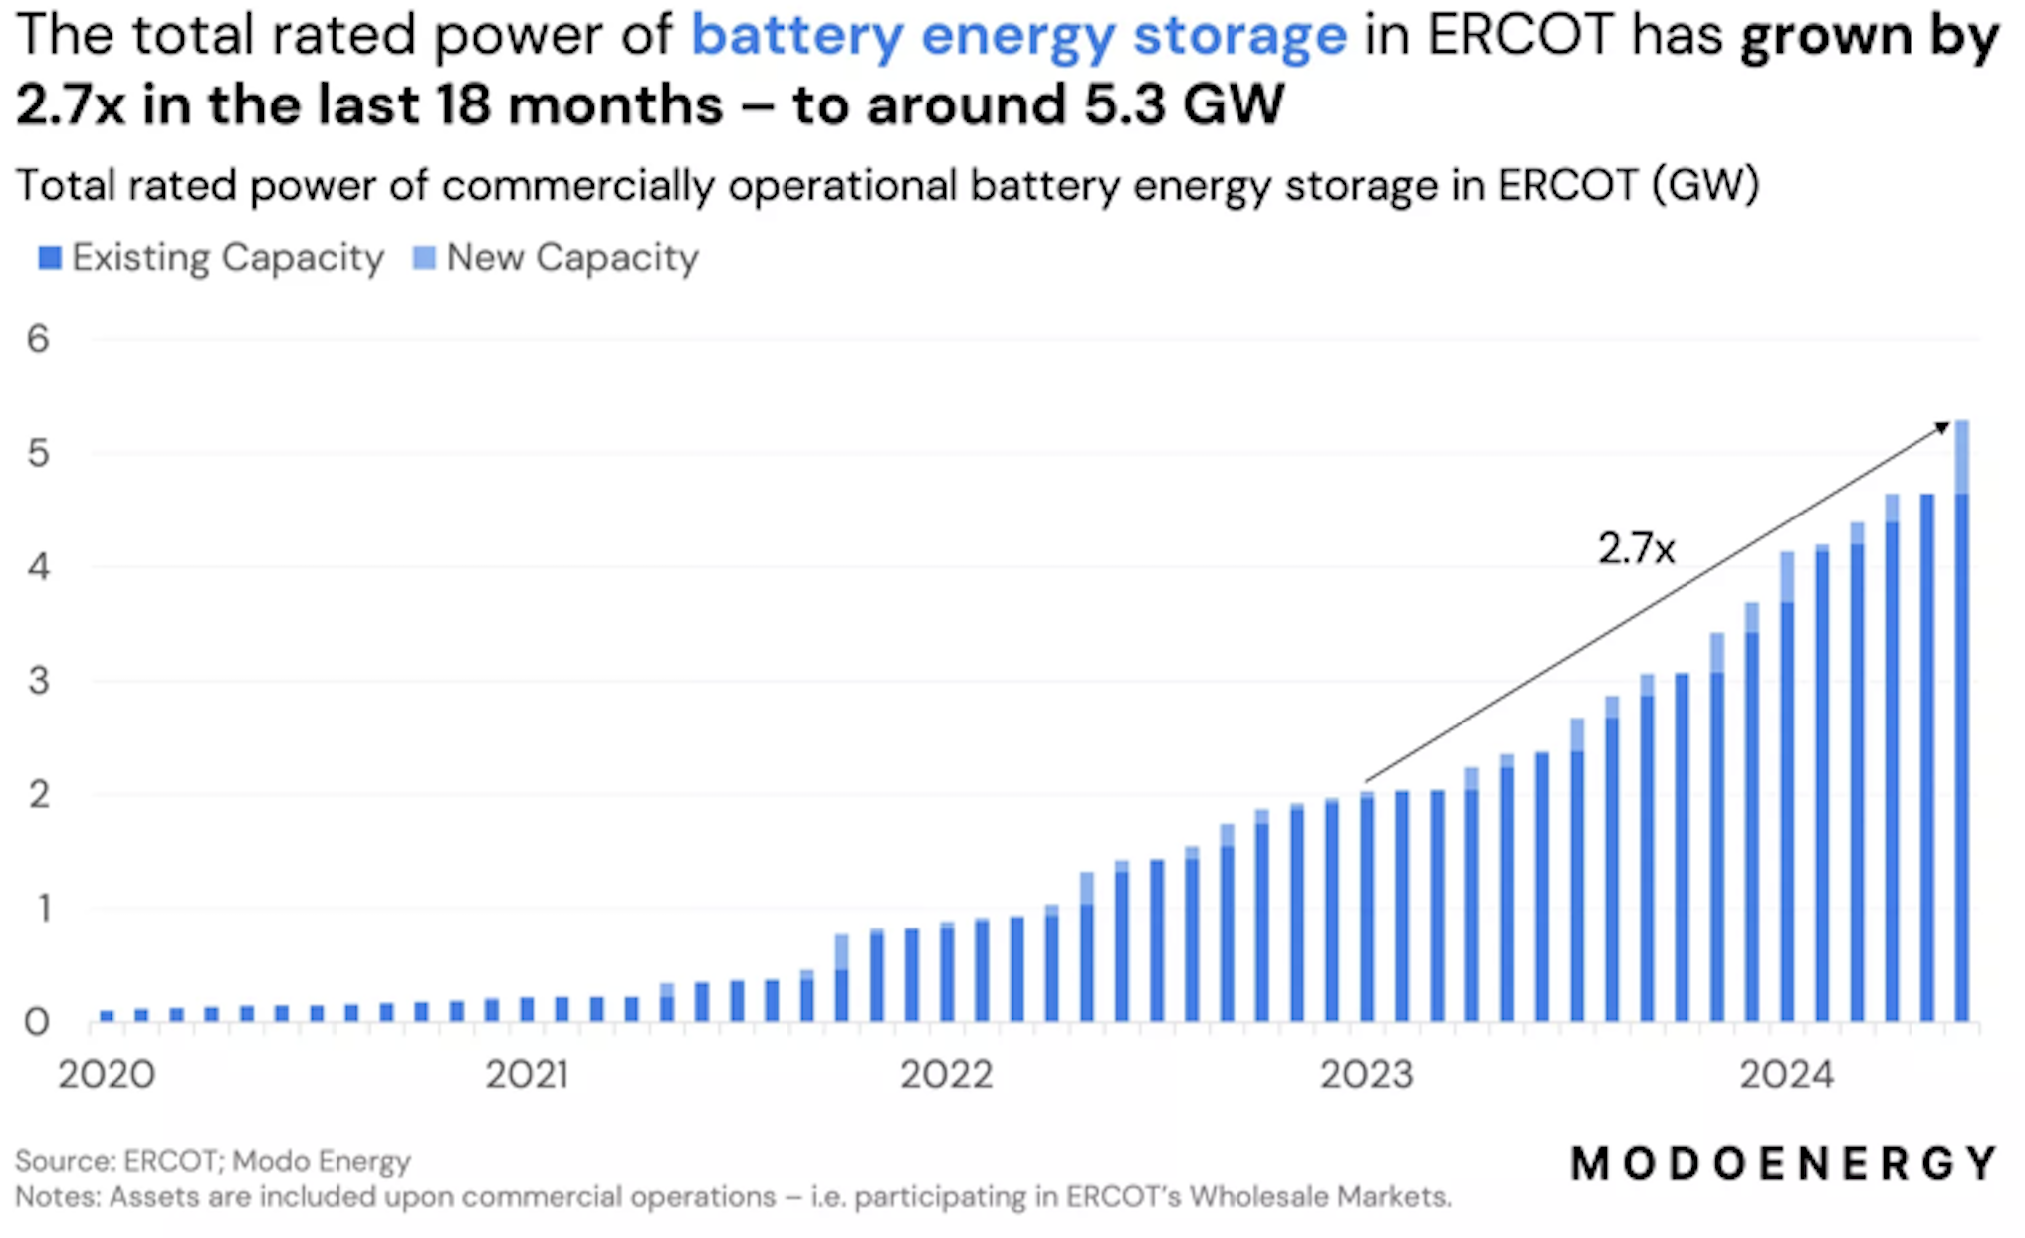
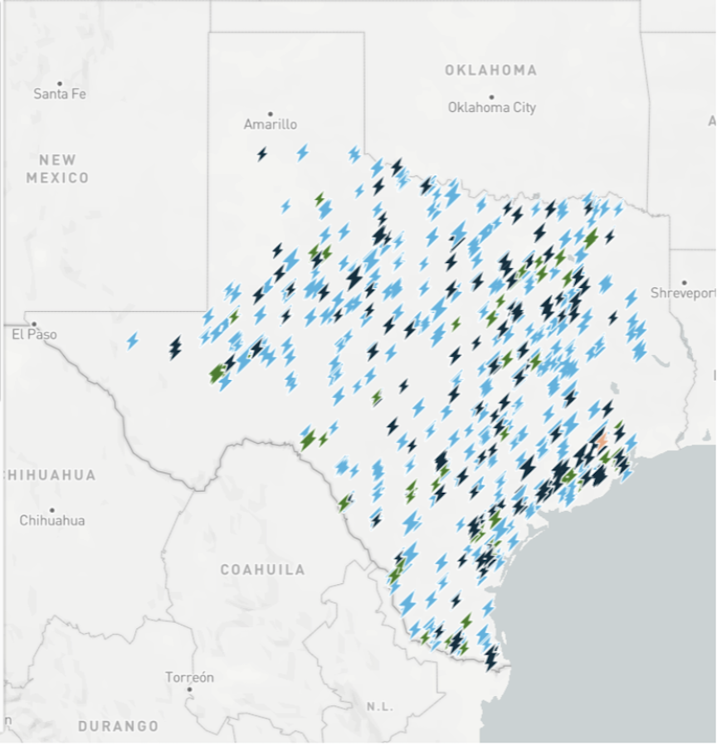
…by deploying batteries

Slide 16
2. Avoiding expensive grid upgrades

Slide 17
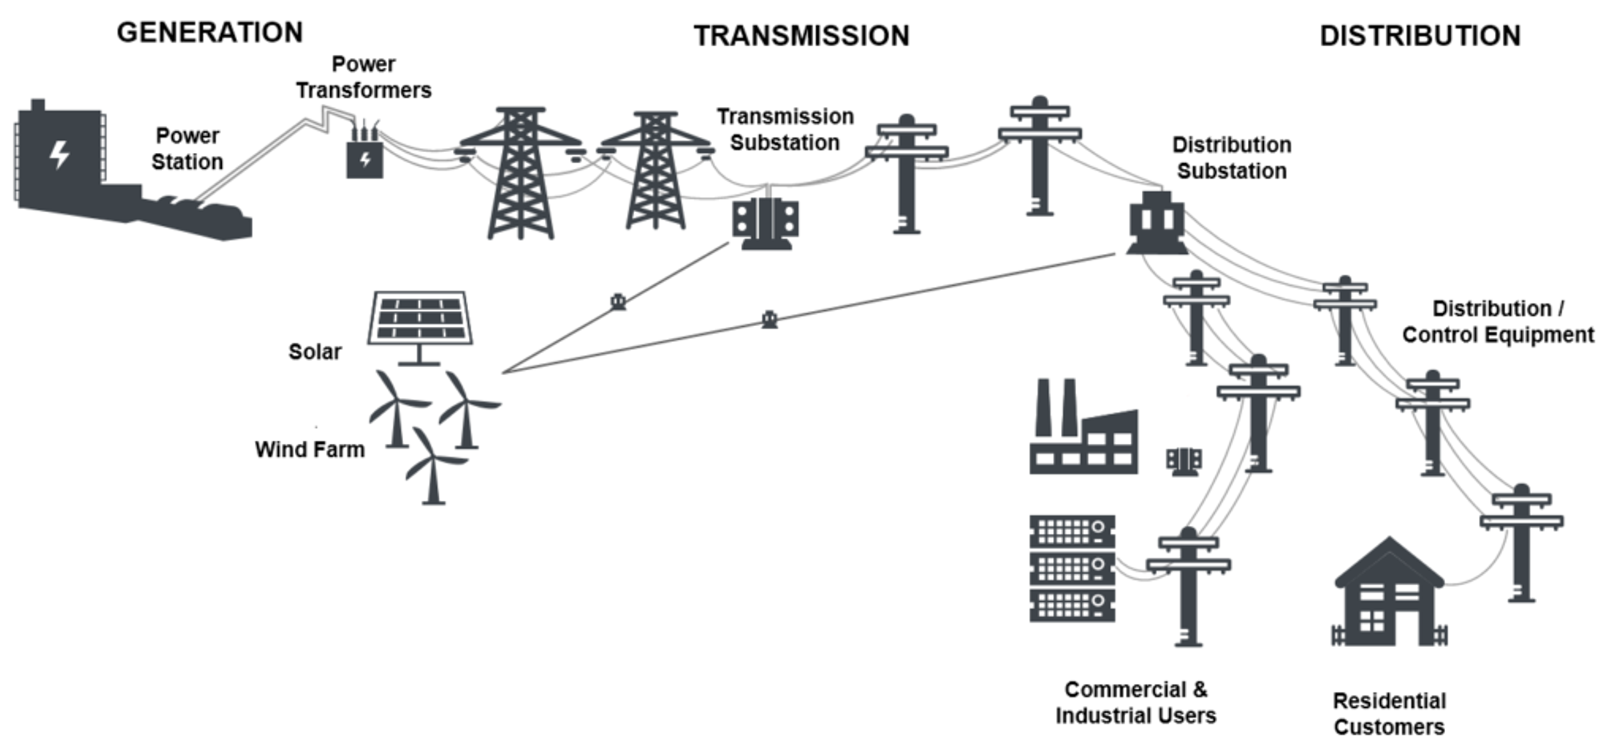
We size the grid to meet peak demand

Slide 18
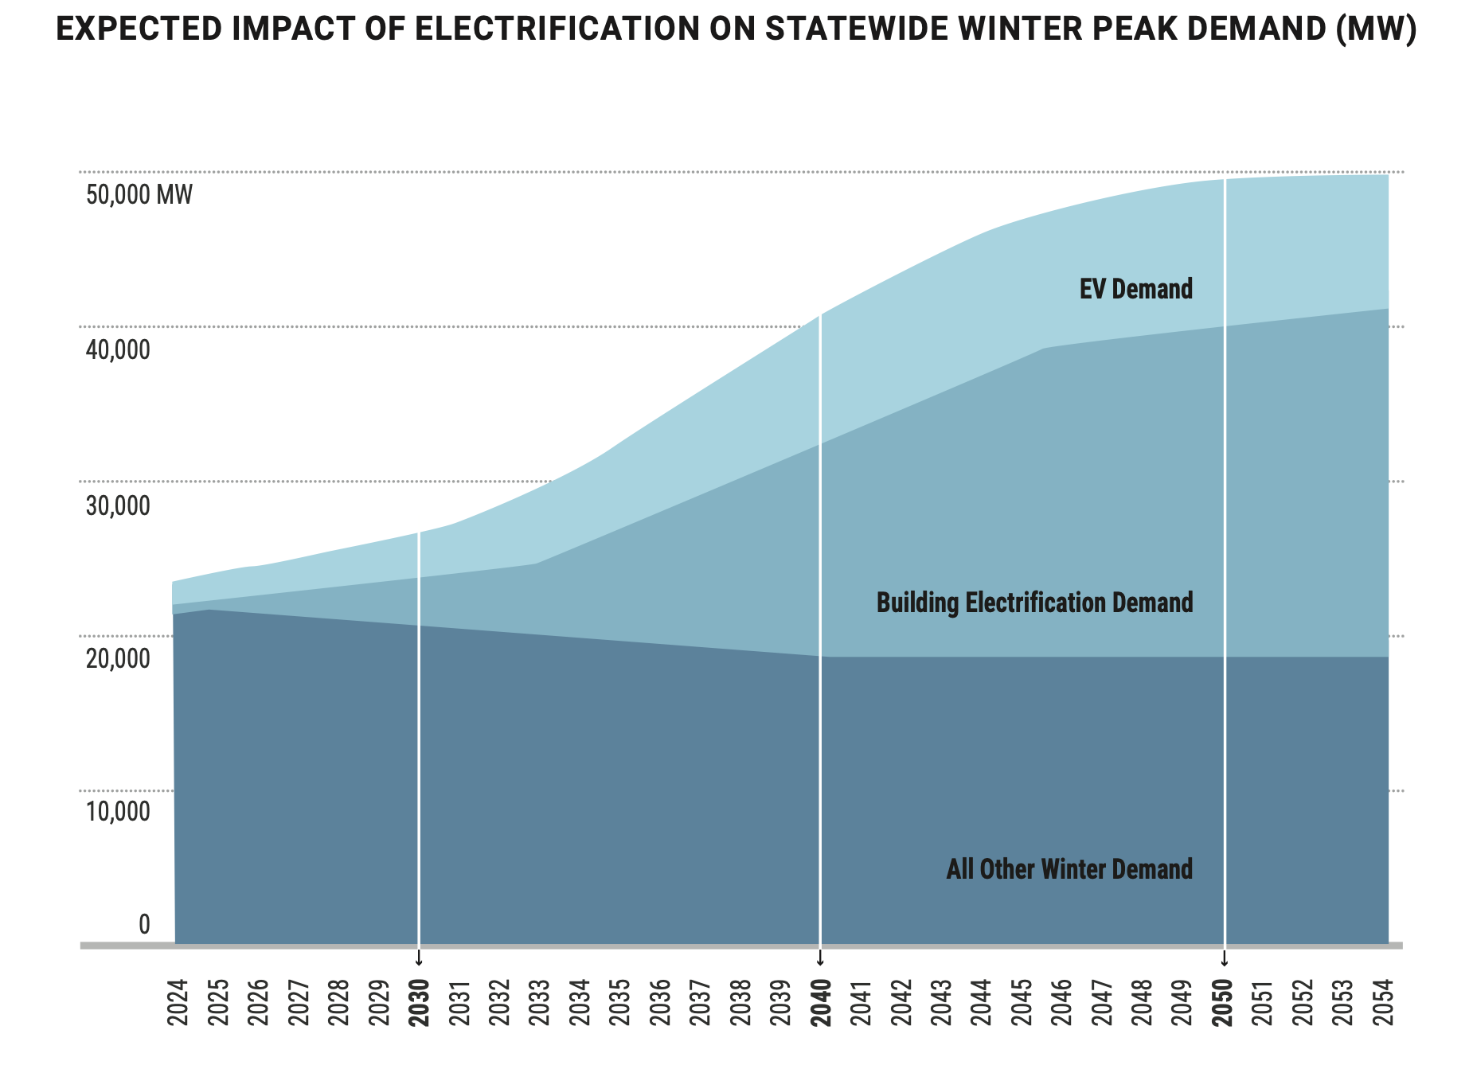
After 20 years flat, electricity demand is growing fast
Source: https://www.nyiso.com/documents/20142/2223020/2024-Power-Trends.pdf

Slide 19
2x-ing grid for 2x current peaks would be very expensive.

Slide 20
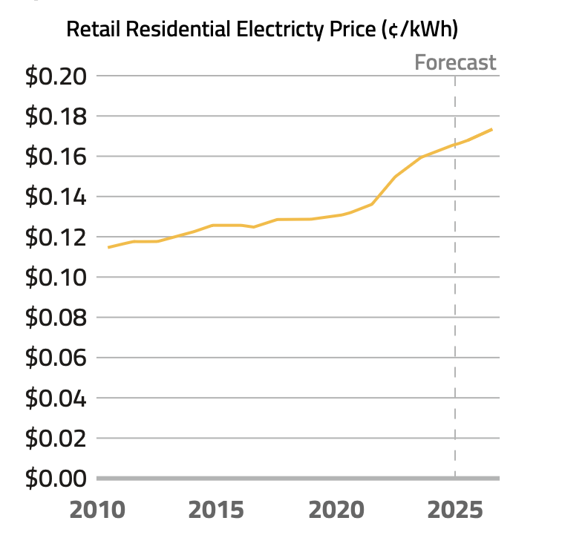
Grid upgrades are already raising electricity bills across the country
Source: U.S. Energy Information Administration www.eia.gov/todayinenergy/detail.php?id=64384

Slide 21
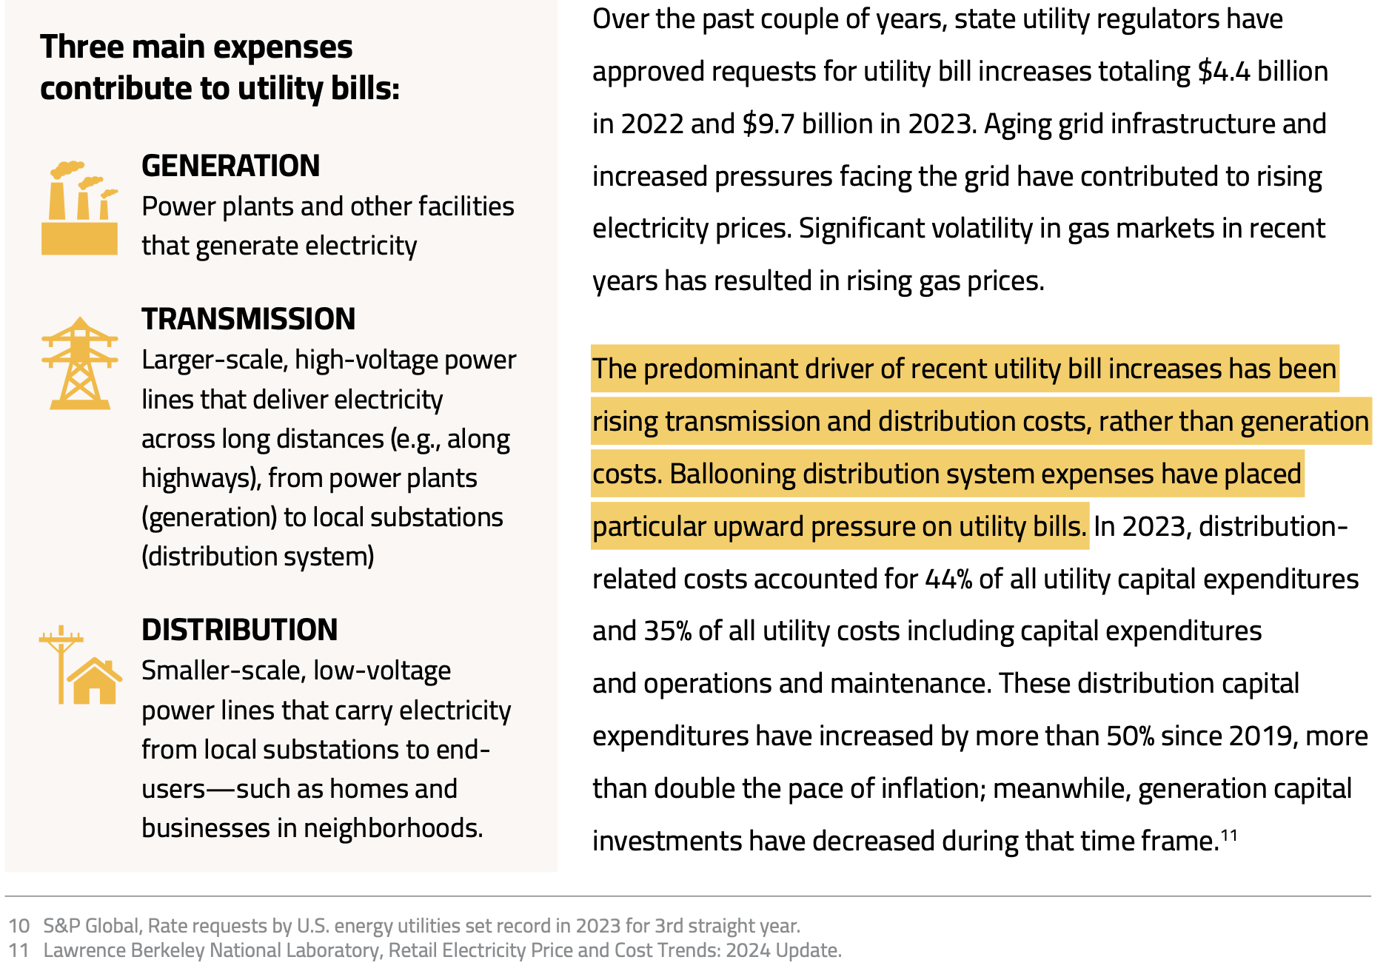
  Source: https://powerlines.org/wp-content/uploads/2025/04/PowerLines_Utility-Bills-Are-Rising_2025-1.pdf

Slide 22
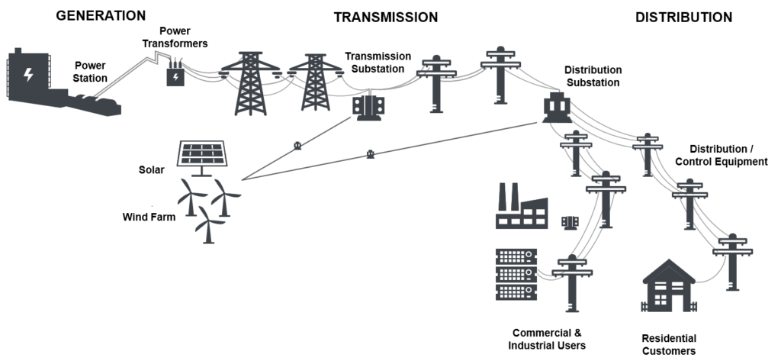
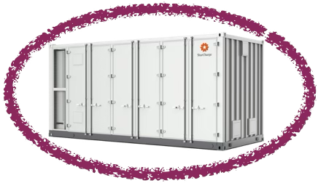
Batteries allow us to get more use out of infrastructure we’ve bought and paid for

Slide 23
…and they help grid avoid outages

Slide 24

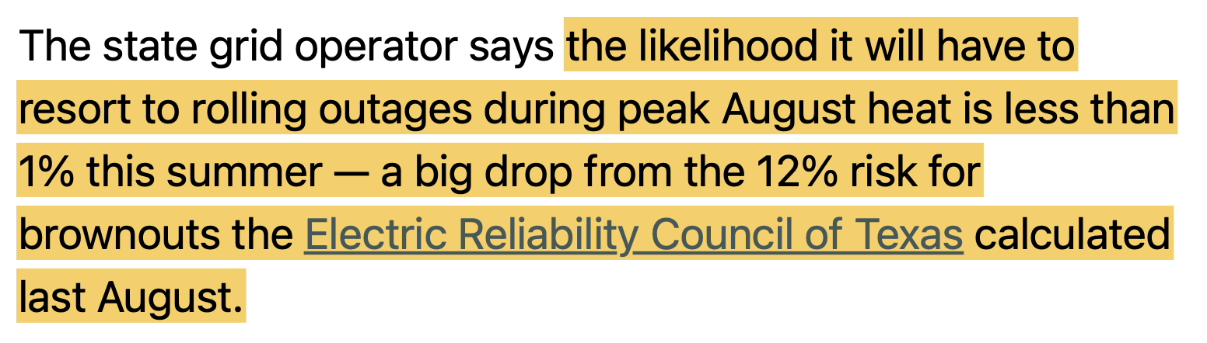
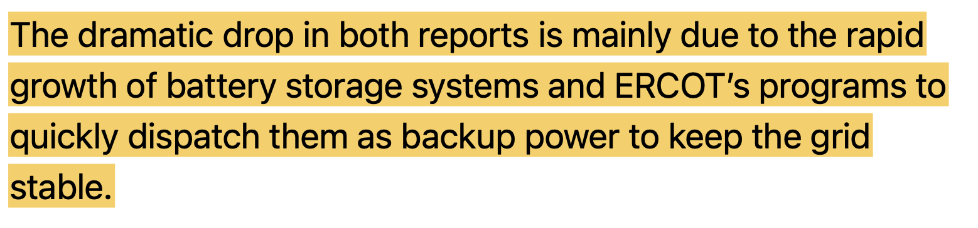
...as Texas has done

Slide 25
Local decisions will either enable this strategy, or block it
2024 study:
Deploying 6000 MW of batteries by 2030 will save NY customers $2 billion

Slide 26
Addendum: Fire safety

Slide 27
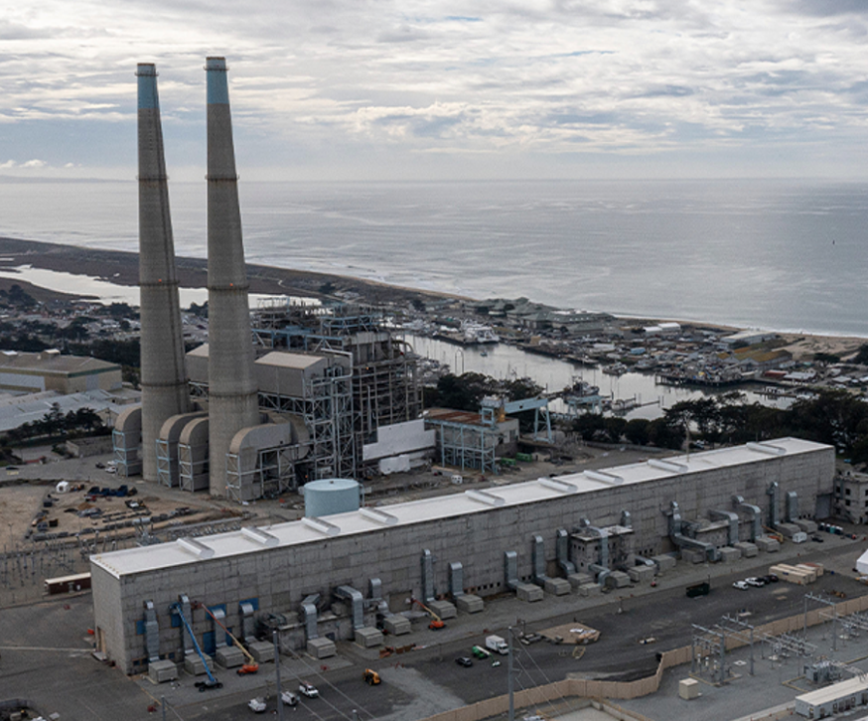
Moss Landing, CA

Slide 28
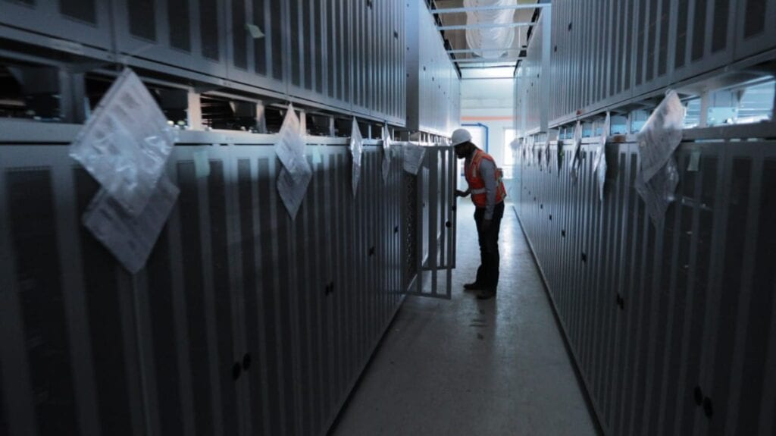
Moss Landing, CA
Batteries Indoors, in re-purposed turbine hall
Packed together, horizontally & vertically
NMC (Nickel, Manganese, Cobalt) batteries
Could not be built today!

Slide 29
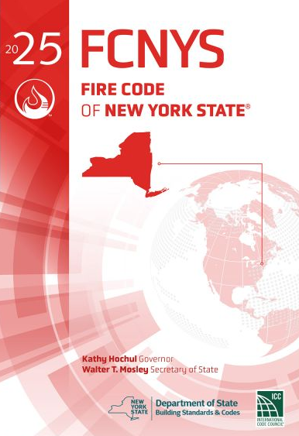
New York’s new Fire Code is most advanced in the US
The following requirements were adopted in 2025 Fire Code of New York State (NYS) based on recommendations from the NYS Inter-Agency Fire Safety Working Group:
  Peer Review
  ERPs and Fire Department Training
  Hazard Support Personnel / Fire Mitigation Personnel
  Explosion Control / Cabinet Exemptions
  Systems Monitoring
  Central Station Monitoring
  Periodic Inspections
  Security of Installations
  Extended Signage

Slide 30
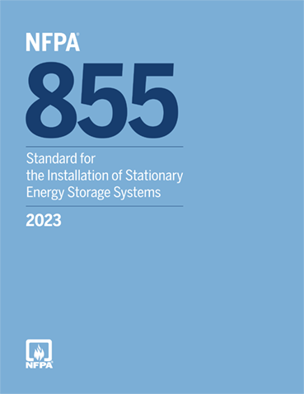
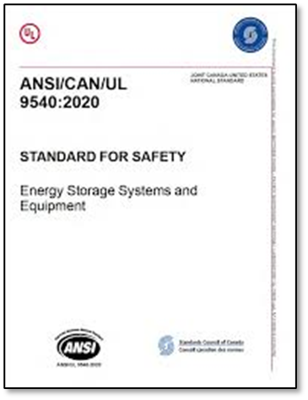
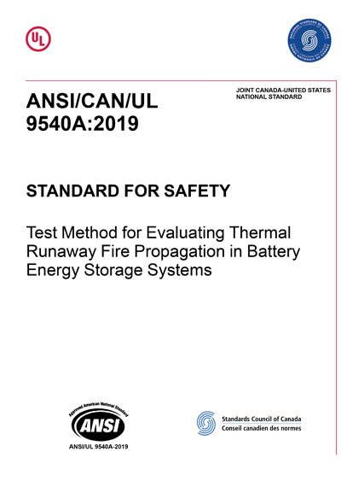

PRIMARY ESS CODES & STANDARDS
National Codes & Standards
Primary Codes / Standards for ESS Installations:
2024 International Fire Code (IFC)
  2025 NYS Uniform Fire Prevention Code Chapter 12 ( Section 1207 )
  NYS Code Allows for Peer Review and Subject Matter Expert (Fire Remediation) (Optional)
NFPA 855 (2023 Edition): Standard for the Installation of Stationary Energy Storage Systems
  Fire Protection Systems including:
    Explosion Protection to NFPA 69 - Exhaust Ventilation or NFPA 68 - Deflagration Venting
    Automatic Fire Alarm and Detection – NFPA 72
Listings / Certifications for ESS and Associated Equipment:
UL 9540: Standard for Energy Storage Systems and Equipment
  Includes:
  UL 1973 for cell, battery, rack
  UL 1741 for inverters
Large-Scale Fire Testing:
UL 9540A: Standard for Test Method for Evaluating Thermal Runaway Fire Propagation in Battery Energy Storage Systems

Slide 31
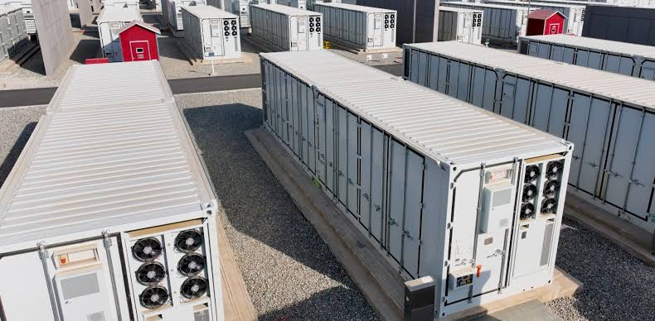
Modern BESS
Outdoor cabinets
Spaced according to UL9540a test results, so that fire cannot propagate beyond one container
Lithium Iron Phosphate (LFP) -- no Nickel, Manganese, Cobalt

Slide 32
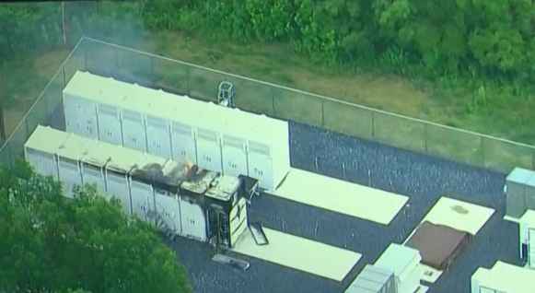
Warwick, NY
“Successful failure”

Slide 33
What about toxins?
The most concerning toxins in BESS smoke are carbon monoxide, hydrogen fluoride, & hydrogen cyanide
During every fire incident: live air monitoring at site permitter
Immediately after every fire incident: DEC or EPA testing of soil, water, swabbing of nearby surfaces
Same as a house fire
In no case have elevated toxin levels been found in air beyond the fenceline
At Moss Landing: Nickel, Manganese, and Cobalt in soil.
In no other case has any toxic residue been found in soil or water beyond fenceline.

Slide 34
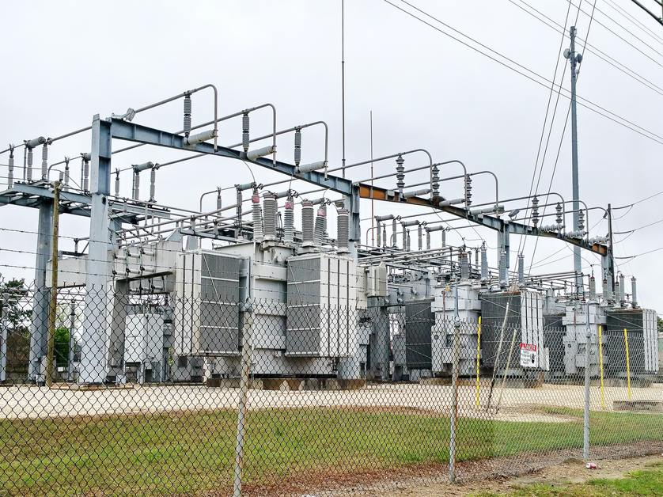
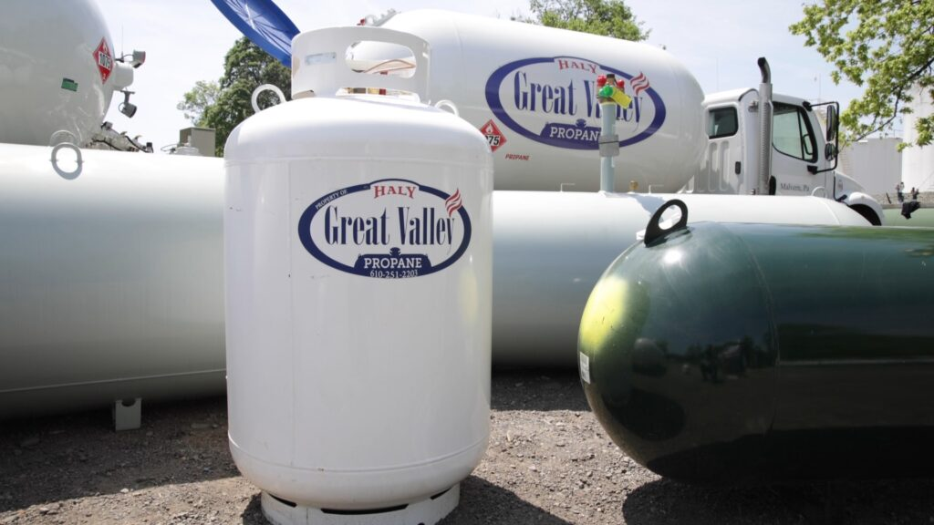
Best practice: let it self-consume, like…

Slide 35
Grid batteries are new to people’s experience
They are less dangerous than other infrastructure we accept and depend on.

Slide 36
Questions?
Jeff Seidman
Vassar College
jeseidman@vassar.edu

