Slide 1
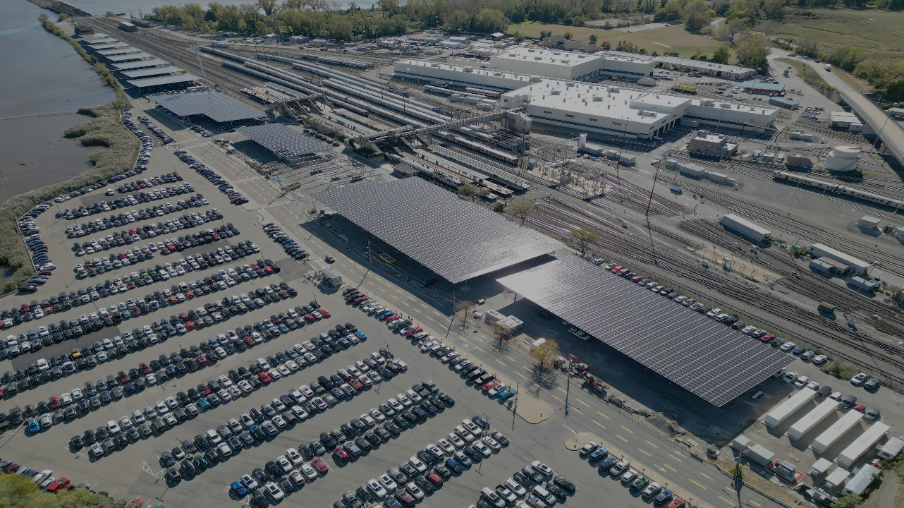
Codes, Cash, and Contracts: Experience From Croton’s Solar Canopy and BESS Facility
Presented to the Orange County Municipal Planning Federation (OCMPF)
May 29, 2026
by (Mr.) Lindsay Audin CEM LEED-AP
chair, Croton Sustainability Committee
Notes:
0
0

Slide 2
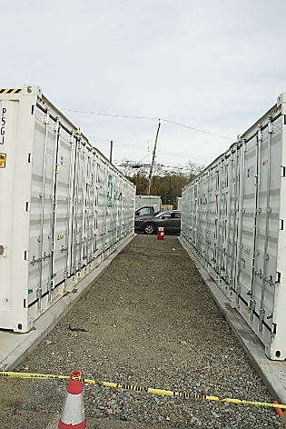
BESS As An Opportunity, Not A Burden
Via its local government, a community can secure financial benefits from a BESS.
Like many light industrial facilities, a BESS can be taxed, regulated, etc. to produce local wealth for the community.
Due to recent changes in IRS tax rules, a “battery gold rush” has developers seeking BESS sites in our region and elsewhere.
Rather than opposing it, municipalities may share in that opportunity by learning how to best leverage it to benefit their constituents.
2

Slide 3
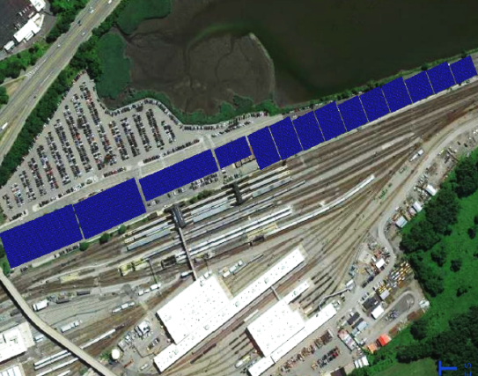

Aerial View of Croton-Harmon Train Station
Croton owns the parking lots and commuters pay to park. Twelve canopies (aka “carports”) along Veterans Plaza hold ~10,000 solar panels.
E
They generate ~4.2 MW of power that charges the 3.5 MW 15 MWhr BESS. That power is then injected into the grid, not for specific use in Croton.
System produces ~5,000 MWhr/yr and avoids ~2,000 MT/yr of GHG (= ~600 cars), atop ~10 acres of blacktop.
Via long-term lease, vendor pays Croton ~$473,000/yr.
N
S
Route 9
W
Veterans Plaza
Solar canopies
Sections H & I
Train Station
Battery Energy
Storage System
Train Yard
3

Slide 4
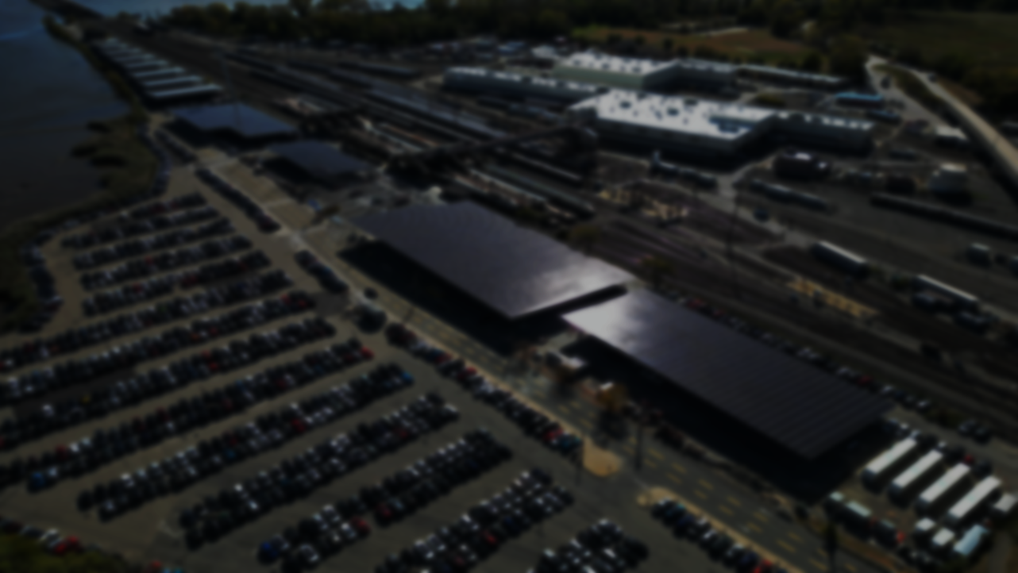
Brief History Of The Croton Project
1964: Croton buys land from NY Central Railroad which previously used it as a trash dump/landfill. Croton made it a paying parking lot.
2017: first canopy designs and rent offerings were too small (~$10K/year) to consider. The Village had no interest in them.
June 2020: COVID seriously cut parking revenue, so Croton’s Village Board sought new revenue. My sustainability committee suggested larger canopies as a no-cost option with rent paid by a developer.
July/August: RFI to 168 developers, RFP to 21, yielded 7 proposals.
March 2021: we rent out our space, not their system, under a lease.
Work (delayed by COVID & other issues) finally begun in late 2022. Substantially completed by early 2025, PTO secured 2026.
Notes:
3
3

Slide 5
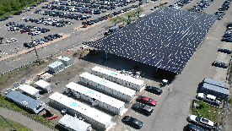
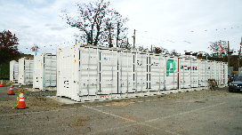
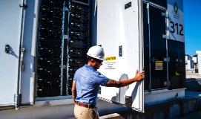
Croton’s 3.5 MW / 15 MWhr BESS…
…has ~100 tons of lithium-iron-phosphate (LFP) batteries in four ~60-foot white steel cabinets. They are ~25% heavier/larger than Li-I NMC units but developers say they have a clean fire safety record.
Each cabinet holds hundreds of batteries, each enclosed in a plastic housing. They hold enough power to run ~700 average homes for 24 hours.
Our BESS is charged by the ~4.2 MW of solar panels atop the canopies. Due to changes in BESS incentives, “standalone” systems (i.e., no solar) are now the norm.
5

Slide 6
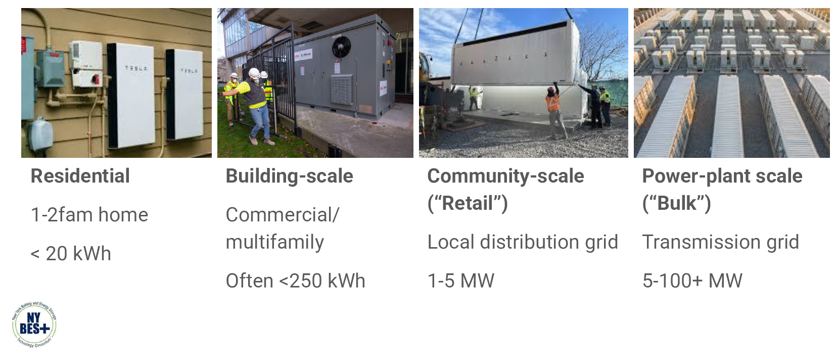
BESS Come In Several Sizes
(EV battery is ~50-100 kWh)

Slide 7

BESS Standards/Codes/Regs
Depending on size (MW & MWhr) and agency:
- Standalone <80 MW: allowed at local level (SEQR and local requirements and/or BESS law) without PSC licensing
- Standalone >80 MW: licensed by NY PSC (PSL §68) ; local SEQR and State/local review/approval may also apply
NY State’s fire code adopted NFPA 855 specs for project design, installation, etc. (as tech changes, NFPA 855 continues to be “tweaked”)
Most (if not all) essential product specs that are now standard in the BESS industry and in the NYS fire code adhere to UL and/or IEEE codes, including:
7

Slide 8
UL 9540 – Certification for complete energy storage systems (batteries + inverters). Confirms the whole unit is safe for installation and operation.
UL 9540A – Fire safety test method for >600 kWh, i.e., >~150 kW. Evaluates how BESS behaves in worst-case thermal runaway. Last revised March 2026 for full-scale tests.
UL 1973 – Standard for stationary (i.e., non-automotive) BESS. Verifies performance, durability, and safety of the cells/modules.
UL 1642 – Lithium battery safety at the individual cell level (short-circuit, overcharge, crush, impact, etc.).
UL 1741 SB – Governs inverters and grid support equipment. Confirms the system can safely connect to the grid, ride through voltage/frequency disturbances, and provide ancillary services.
IEEE 1547– Rules for grid interconnection (voltage, frequency response, islanding protection, etc.).

Slide 9
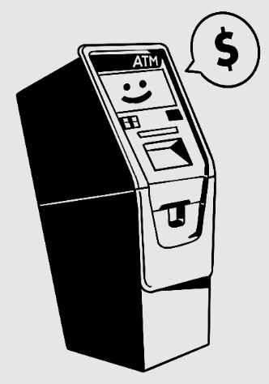
Why Host A BESS?
Think of it as a big ATM or cash machine.
It has no on-site employees; no traffic or offices; needs no water, sewers, or fuel; emits no odor and little sound. It performs a function that dispenses wealth - some of which may be accessed for municipal/community benefits.
It “arbitrages” the value of power by charging up when wholesale electric pricing is low, and discharging when it spikes. A BESS also gets money from grid and utility “ancillary services” programs and State/utility incentives.
9

Slide 10
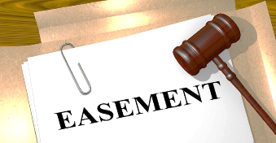
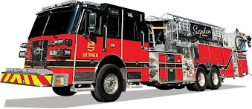
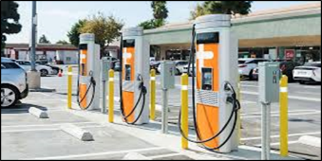
Potential Revenue/Value From BESS
For a community, it could be in the form of…
direct funds from taxes, rent, permit fees, etc.
annual charges for easements or rights-of-way
fees for SEQR and other required/legal analyses
in-kind contributions, e.g., new fire truck, a power conduit for an adjacent EV charging station
some of the federal 30% DirectPay incentive
payment for ongoing municipal services, e.g., annual fire inspections, MW operating license
donation(s) to schools, community center, etc.
For other options, use your municipal imagination!
10

Slide 11
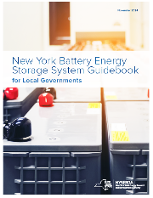
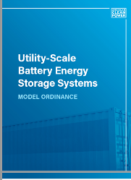
BESS Contractual Issues
Adopt a BESS ordinance using the latest guidebooks. It can help “leverage” available zoning, building, fire safety, and environmental codes/laws, using permits, fees, taxes, etc.
In addition to such laws, leasing contracts provide options for exercising authority. Property owners: never own or lease a BESS. A BESS should be merely a tenant under a lease.
For example, owners may specify LFP in a property lease (not a zoning law) and impose/negotiate additional terms.
Include all usual leasing conditions, e.g., decommissioning bond, noise limits, etc. that you would apply to other tenants.
But avoid burdening a BESS project any more than you would a comparable facility, e.g., warehouse, factory, self-storage.
11

Slide 12
BESS Site Lease Issues
Base the rent on MW/MWhr in case of expansion or better tech
Avoid linking rent to State/federal/utility incentives or other $ issues
Start rent when lease is signed; include annual rent % escalator
Limit visual impact: opaque fence, foliage border + maintenance
Bar unrelated use of space, easement, or right-of-way, e.g., no office, store, storage, fabrication, water well, PV, routine parking
Make security cameras police-accessible, with bright security lights
Restore all excavation from feeder extension, easement, etc.
Require visible metal signage on who/how to call re: emergencies
12

Slide 13
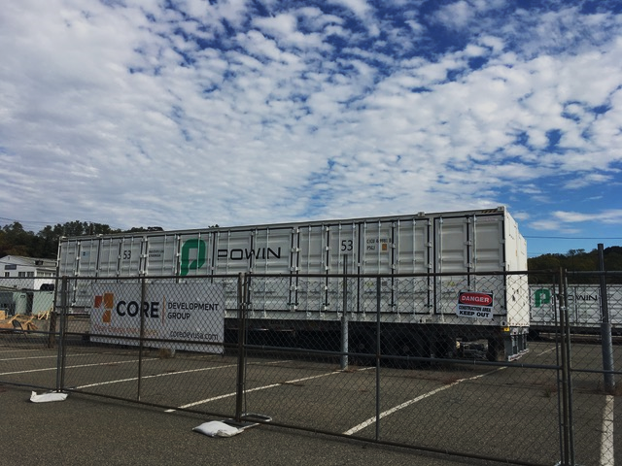
Thank you for your time and attention.
For consultations, email Lindsay directly at energywiz@aol.com
Notes:
12
12
12

